Slide 1
DESIGN OF STEEL STRUCTURAL ELEMENTS (18CV61)
MODULE 01 – CHAPTER 01 INTRODUCTION

Slide 2
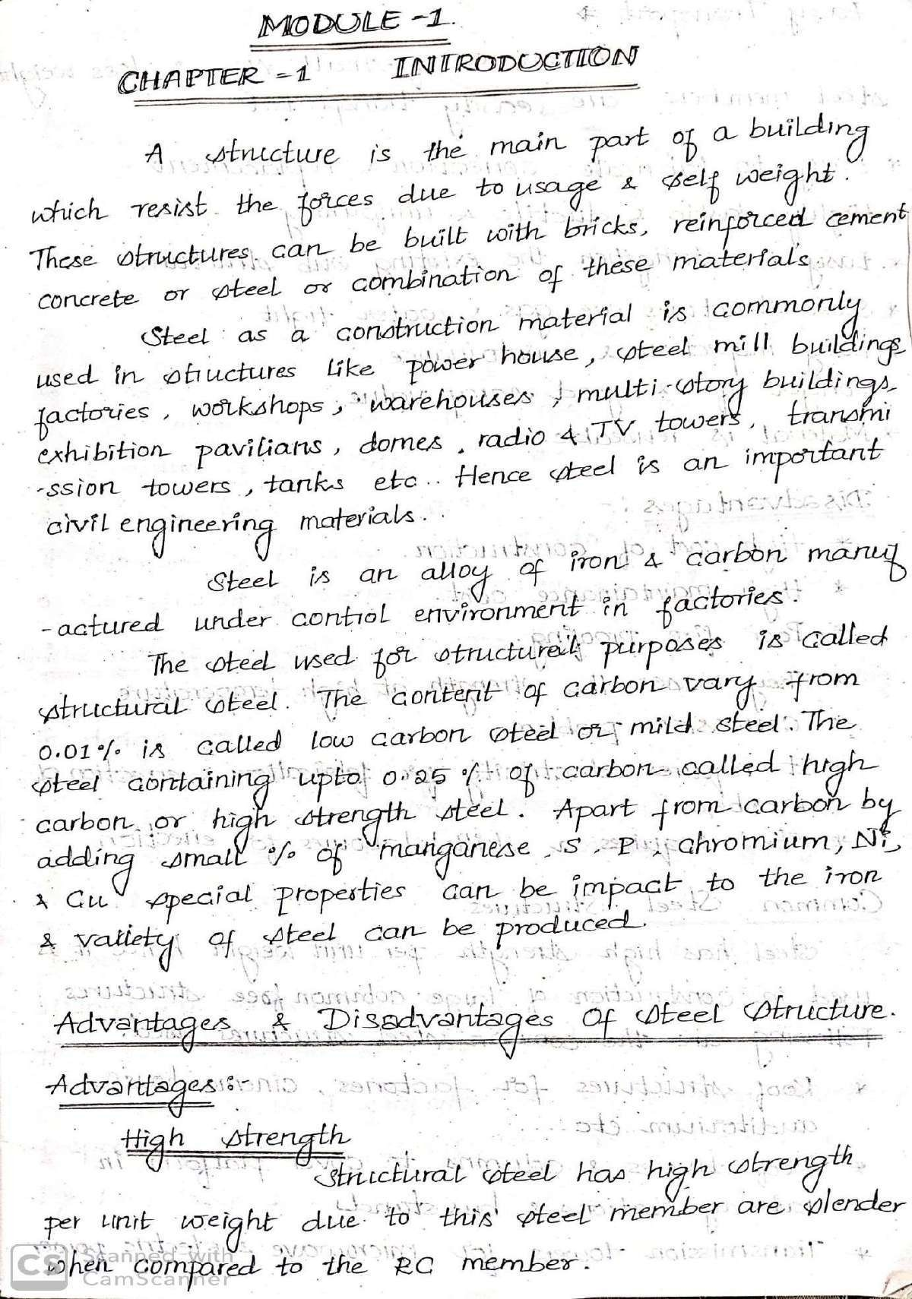

Slide 3
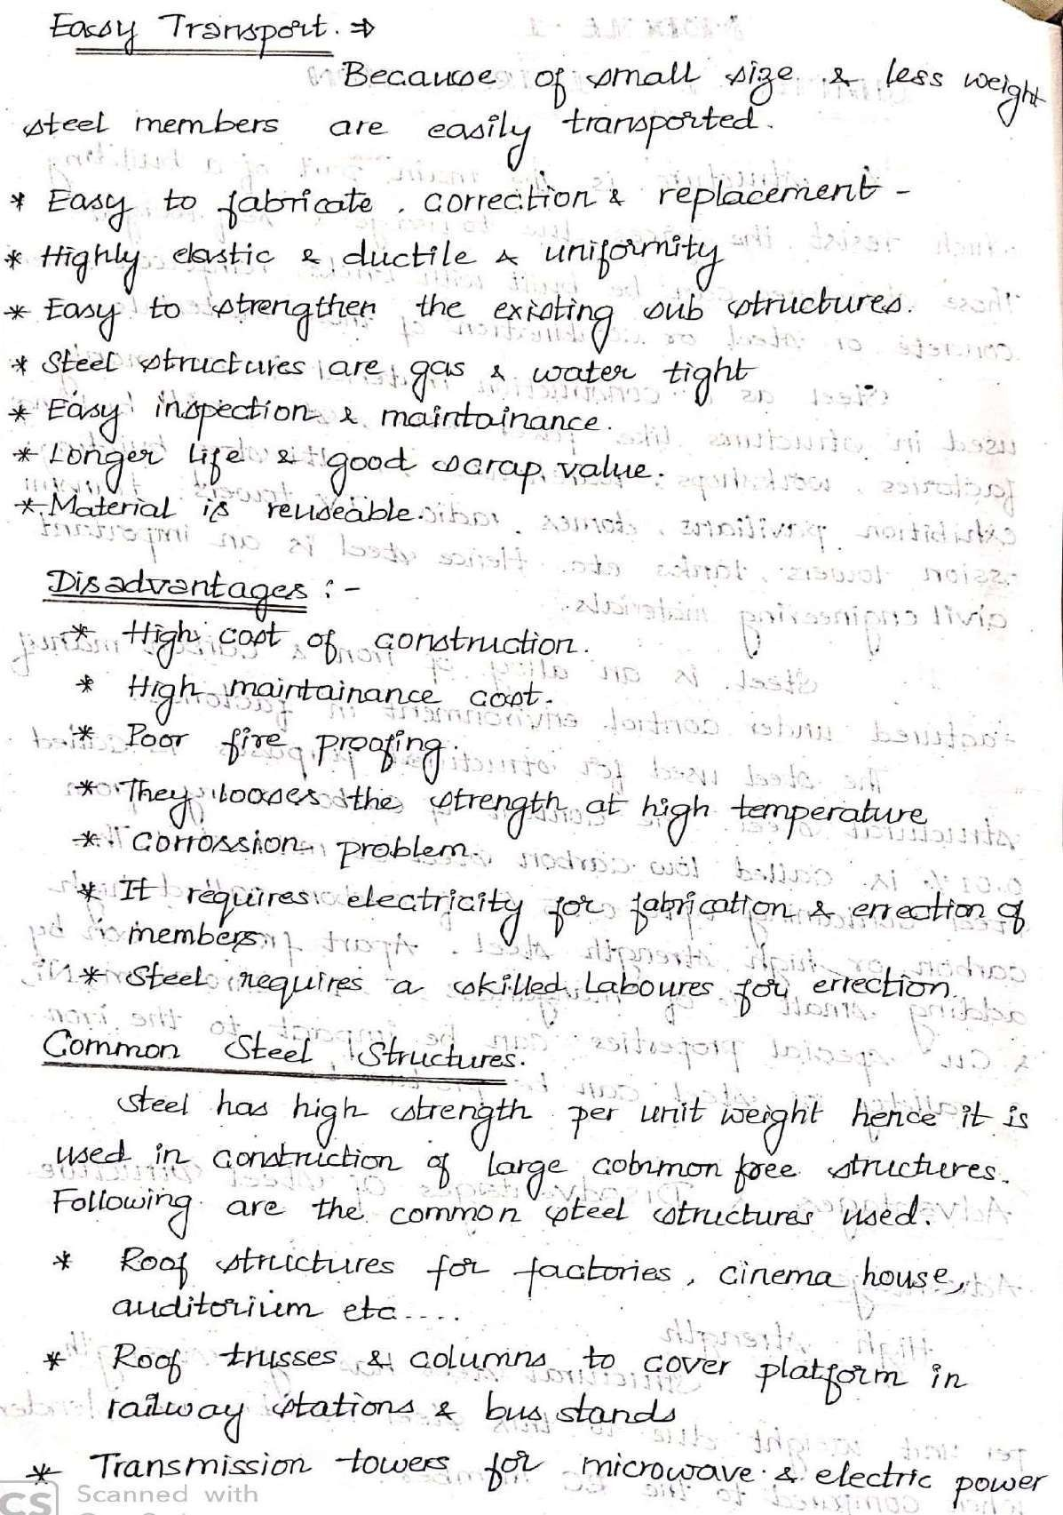

Slide 5
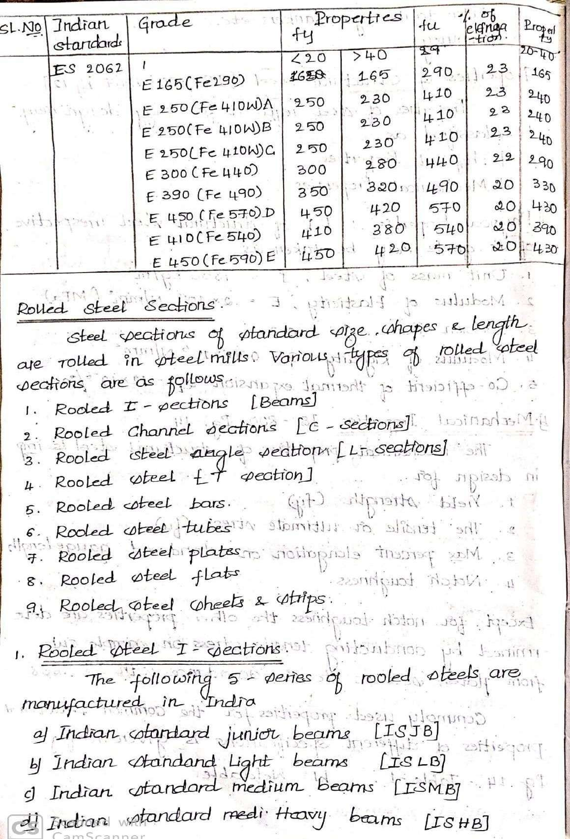

Slide 6
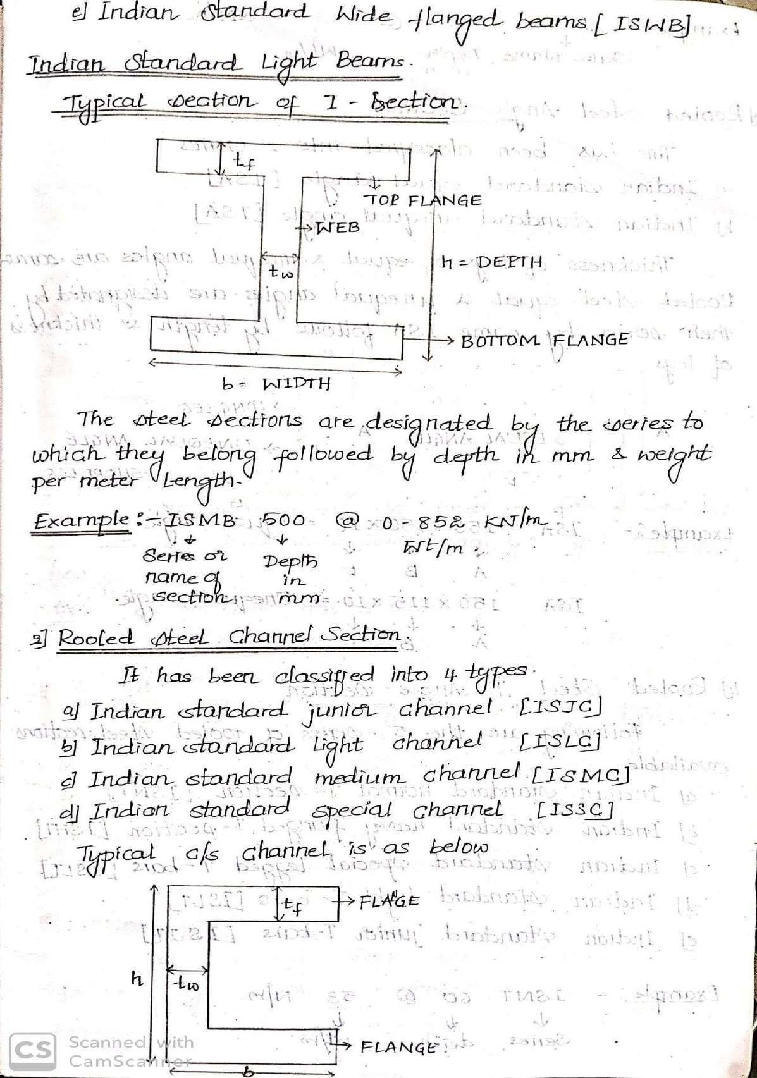

Slide 7
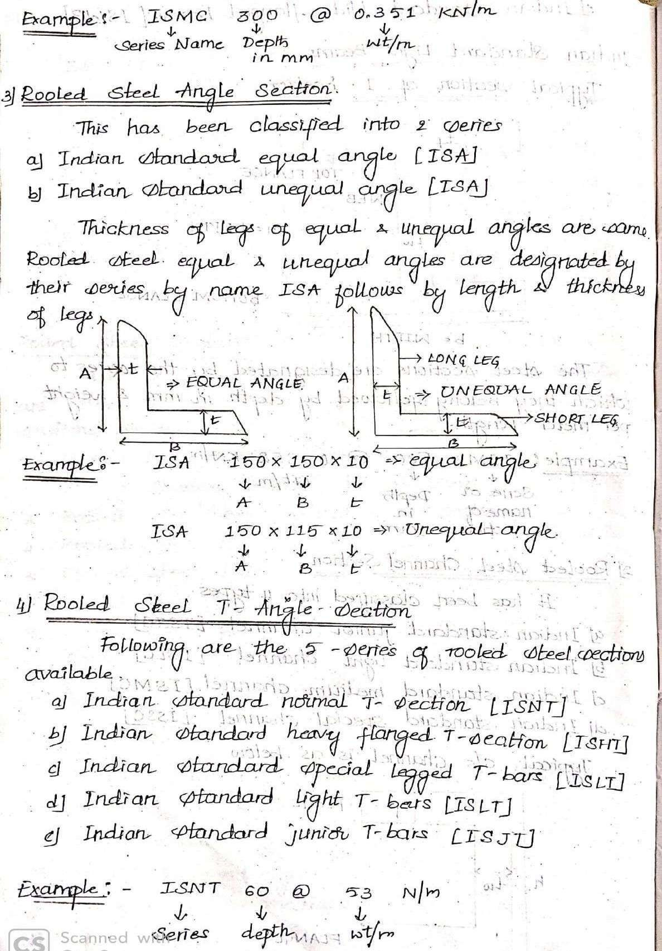

Slide 8
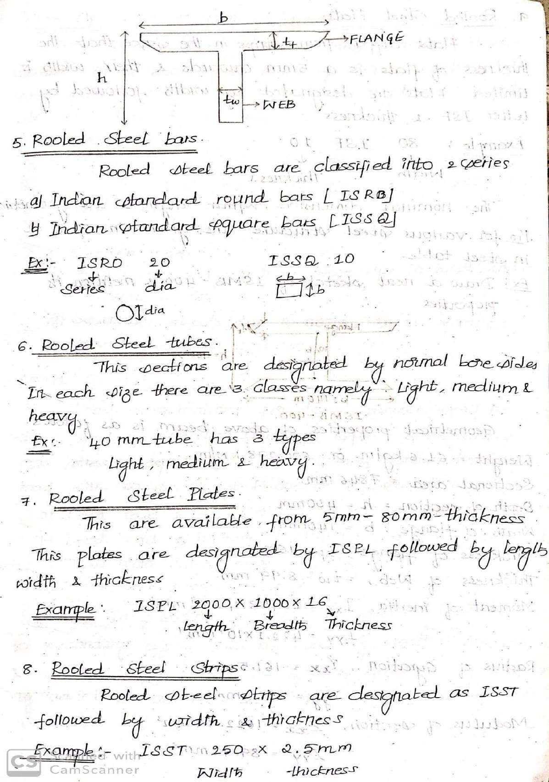

Slide 9
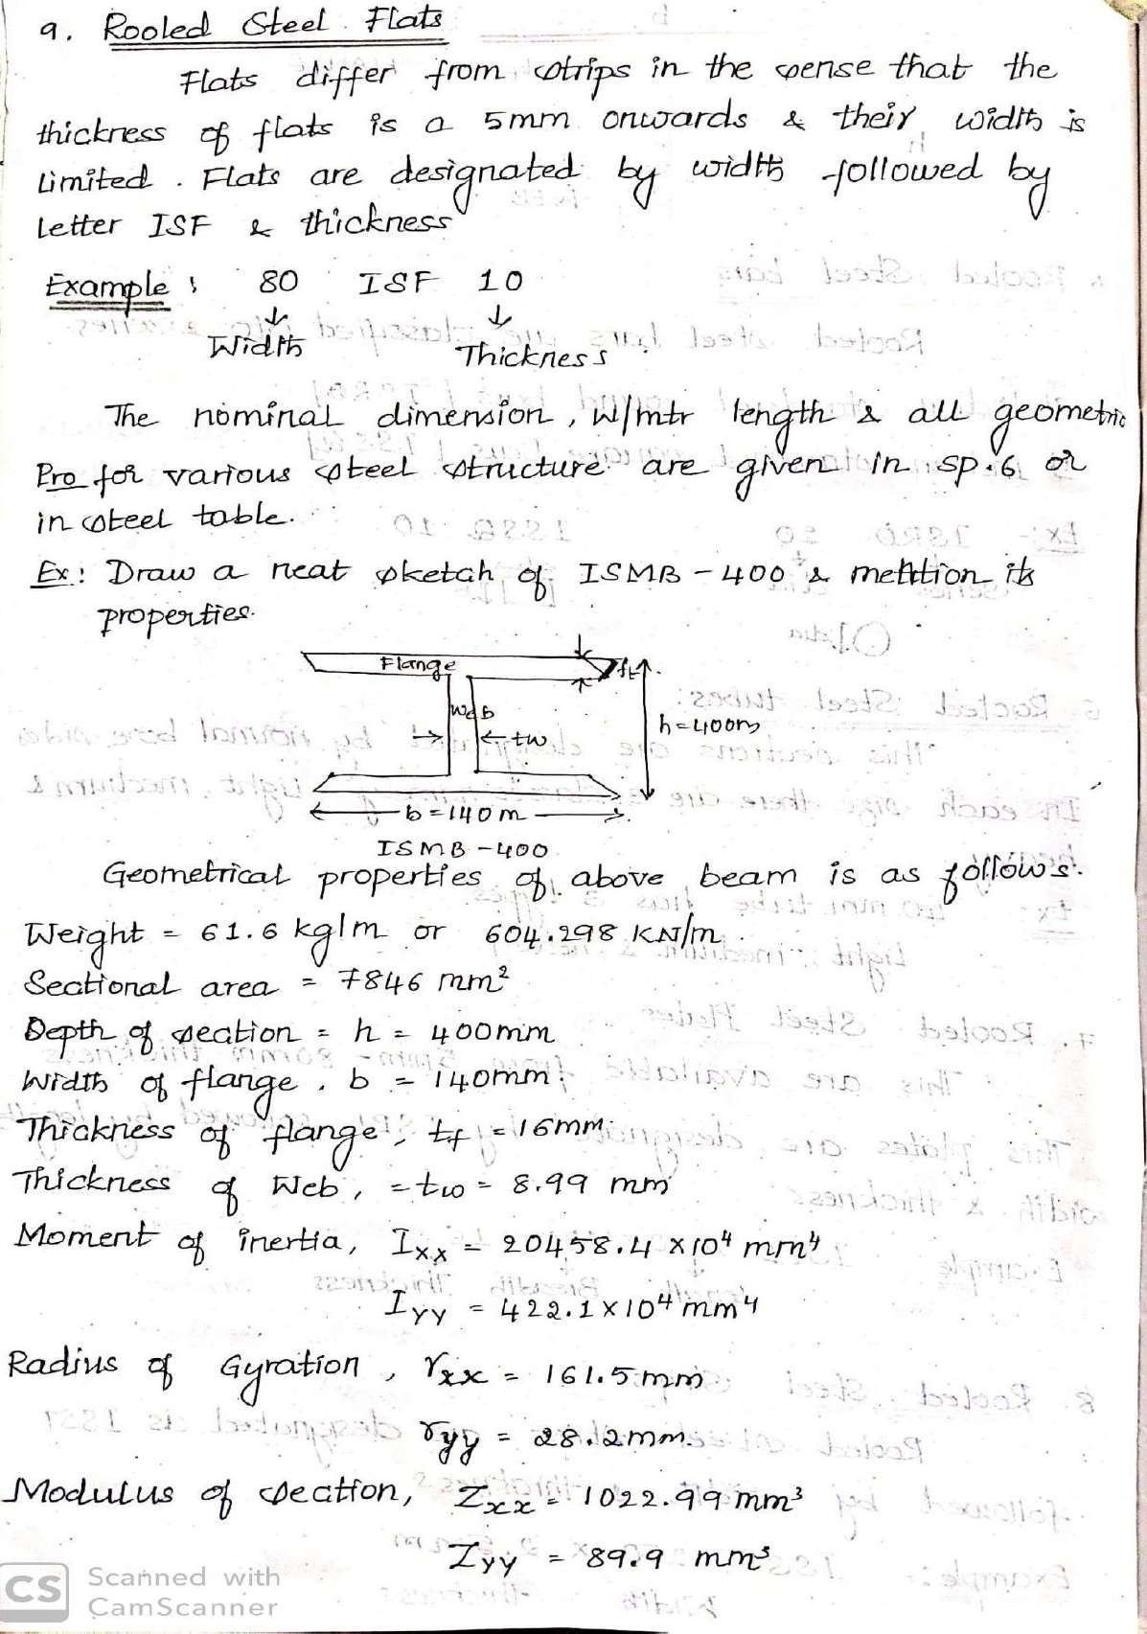

Slide 10
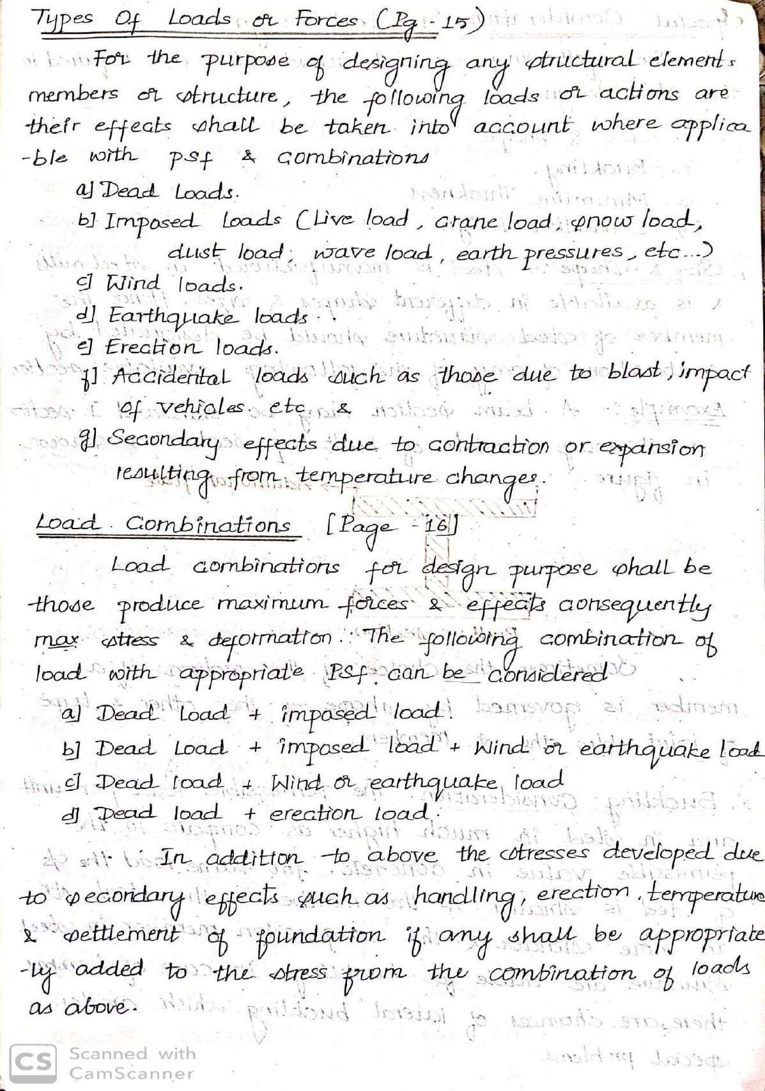

Slide 12
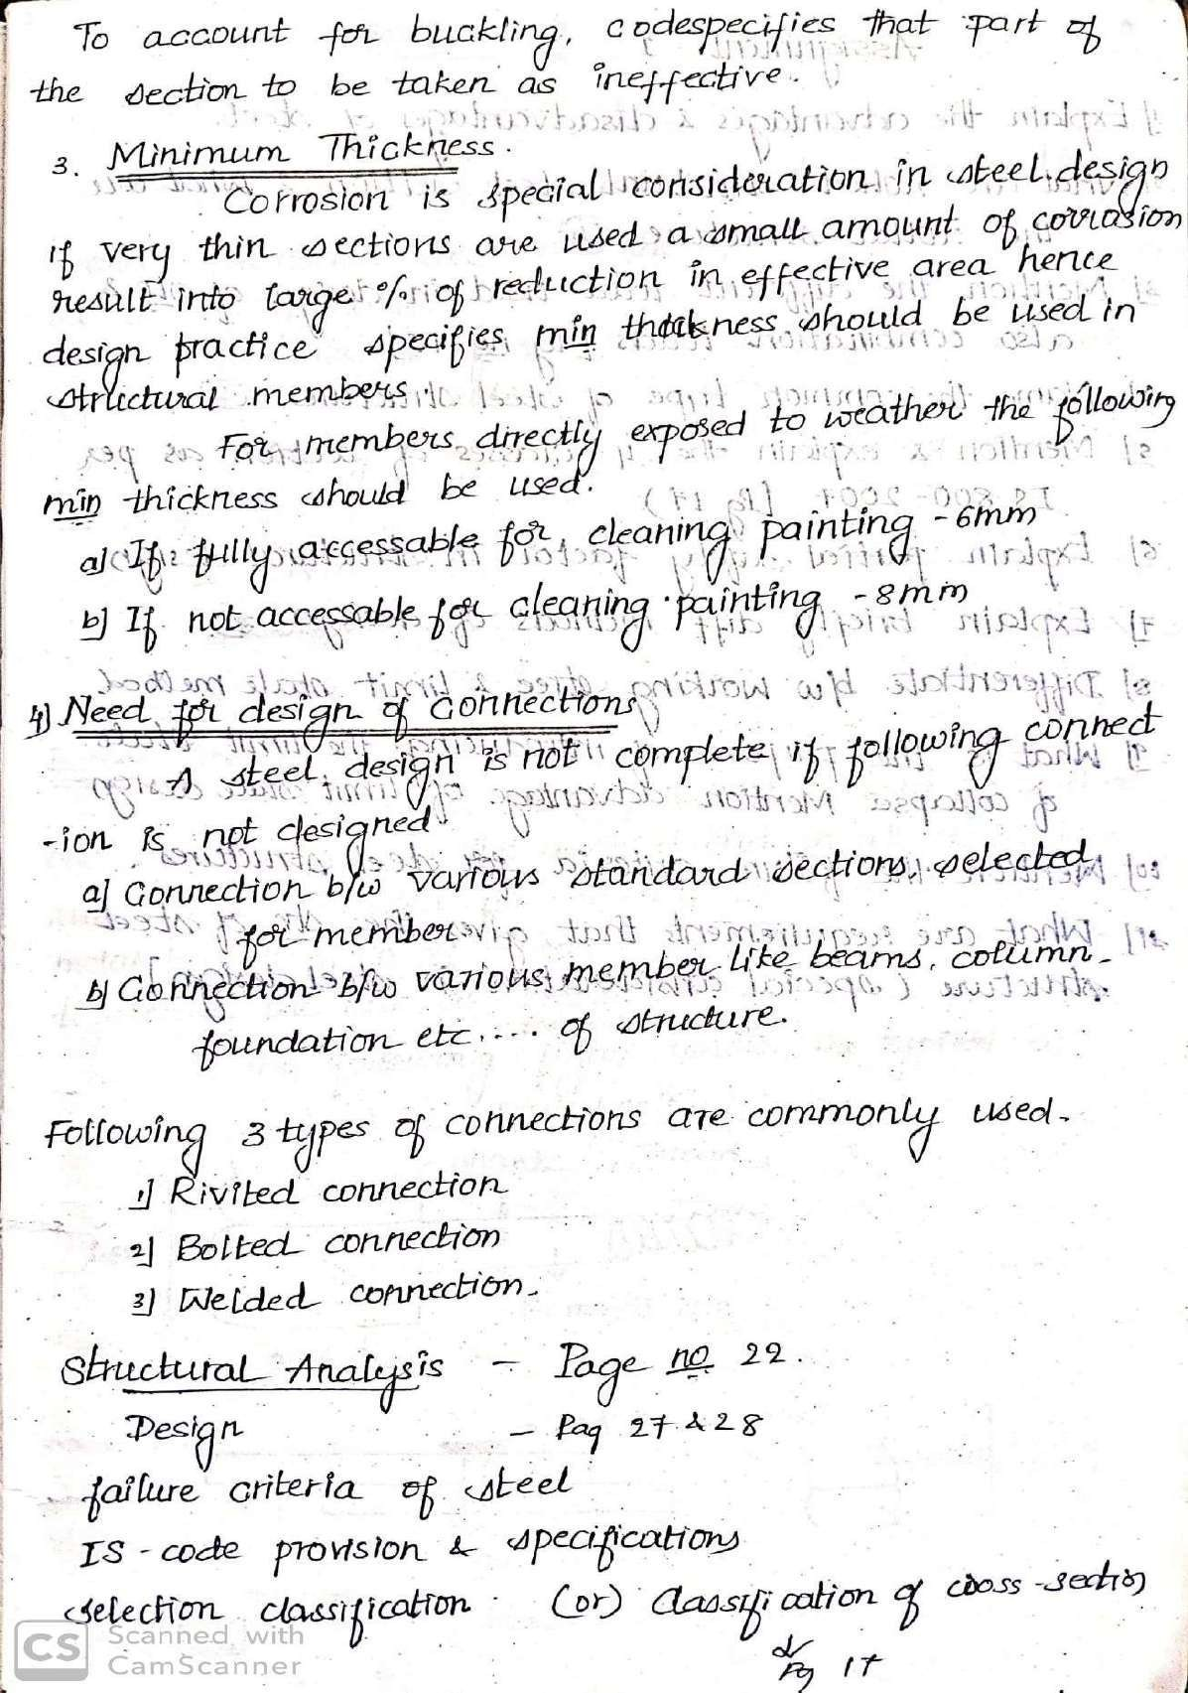

Slide 13
DESIGN OF STEEL STRUCTURAL ELEMENTS (18CV61)
Module 02
BOLTED CONNECTIONS
1

Slide 14
2

Slide 15
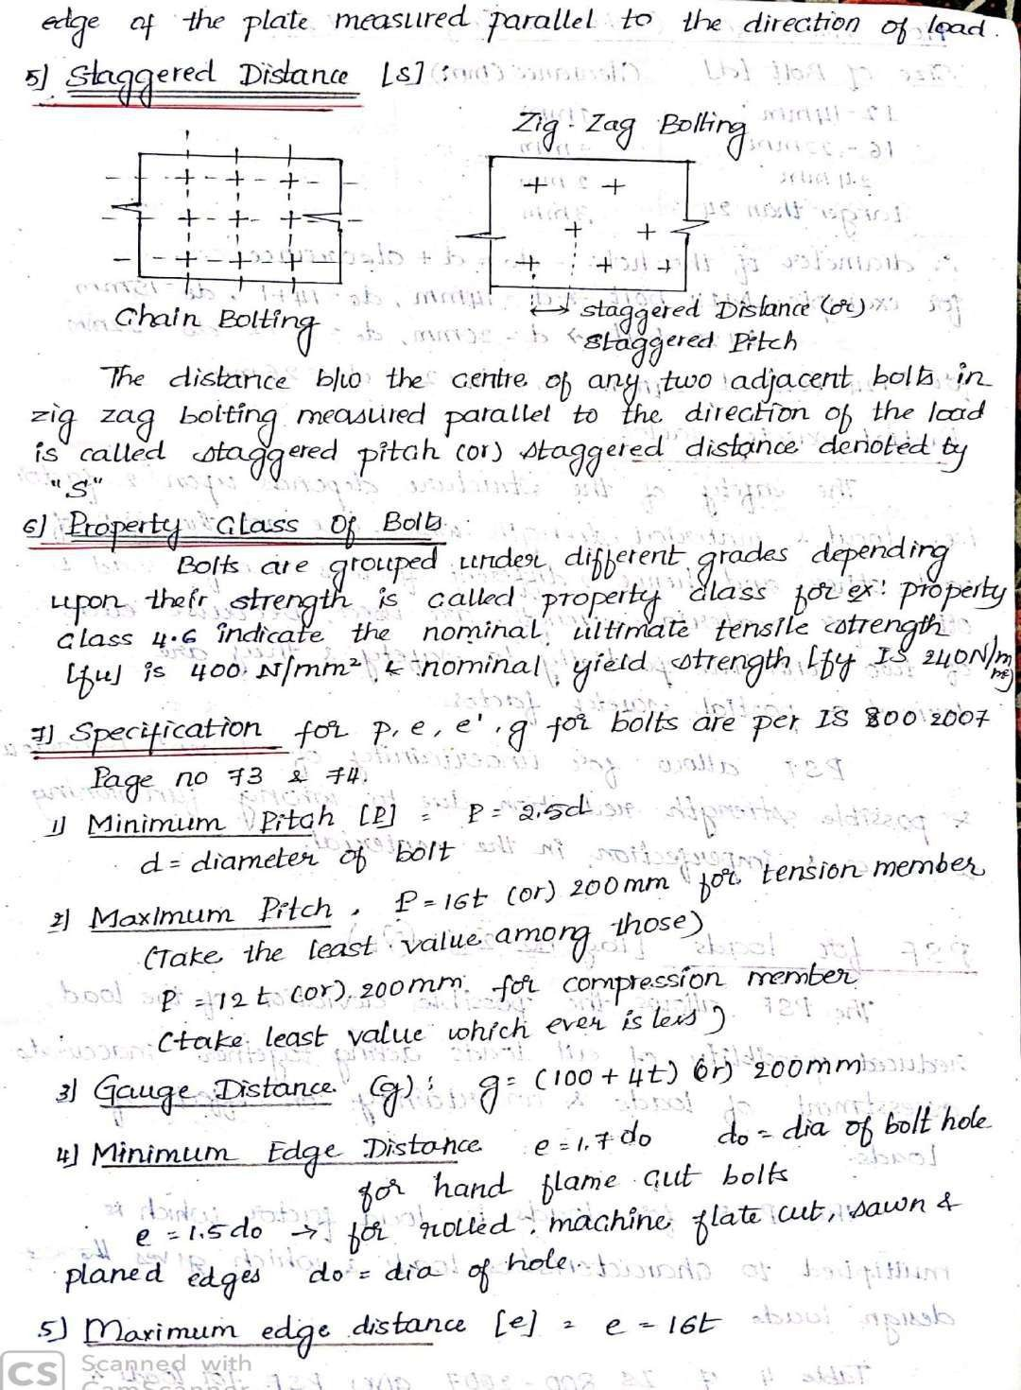
3

Slide 16
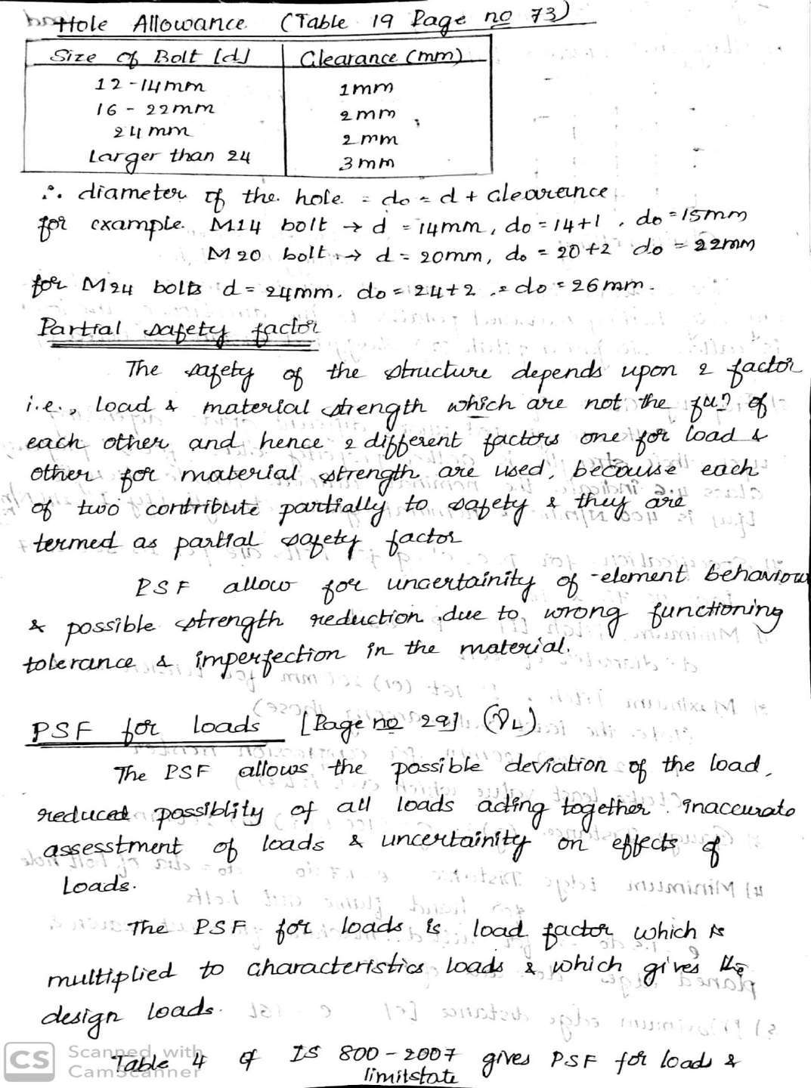

Slide 17
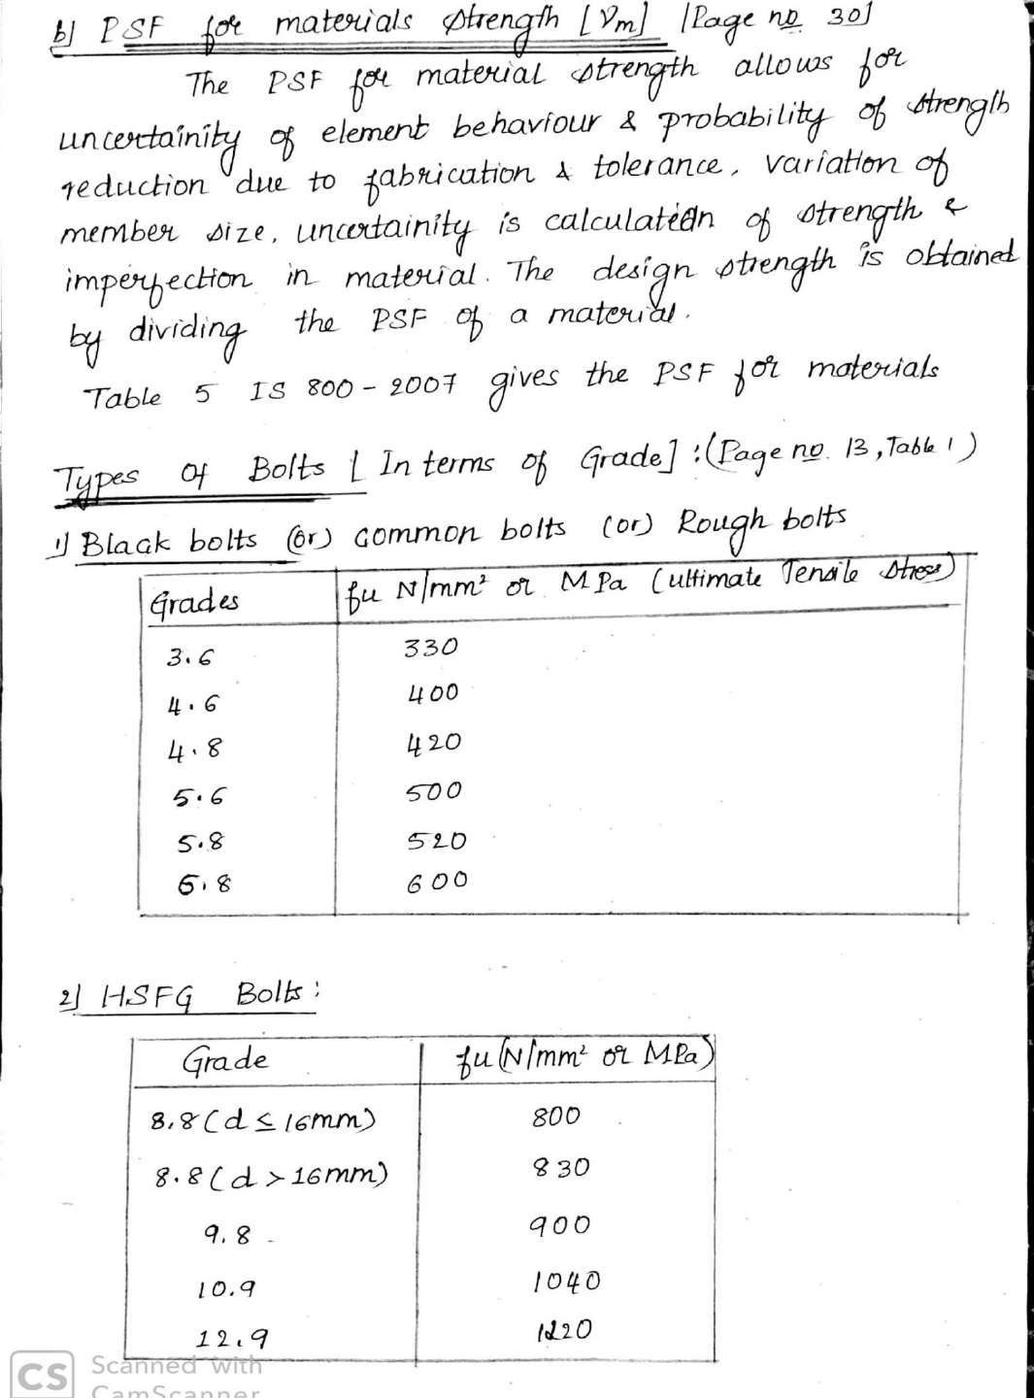

Slide 18
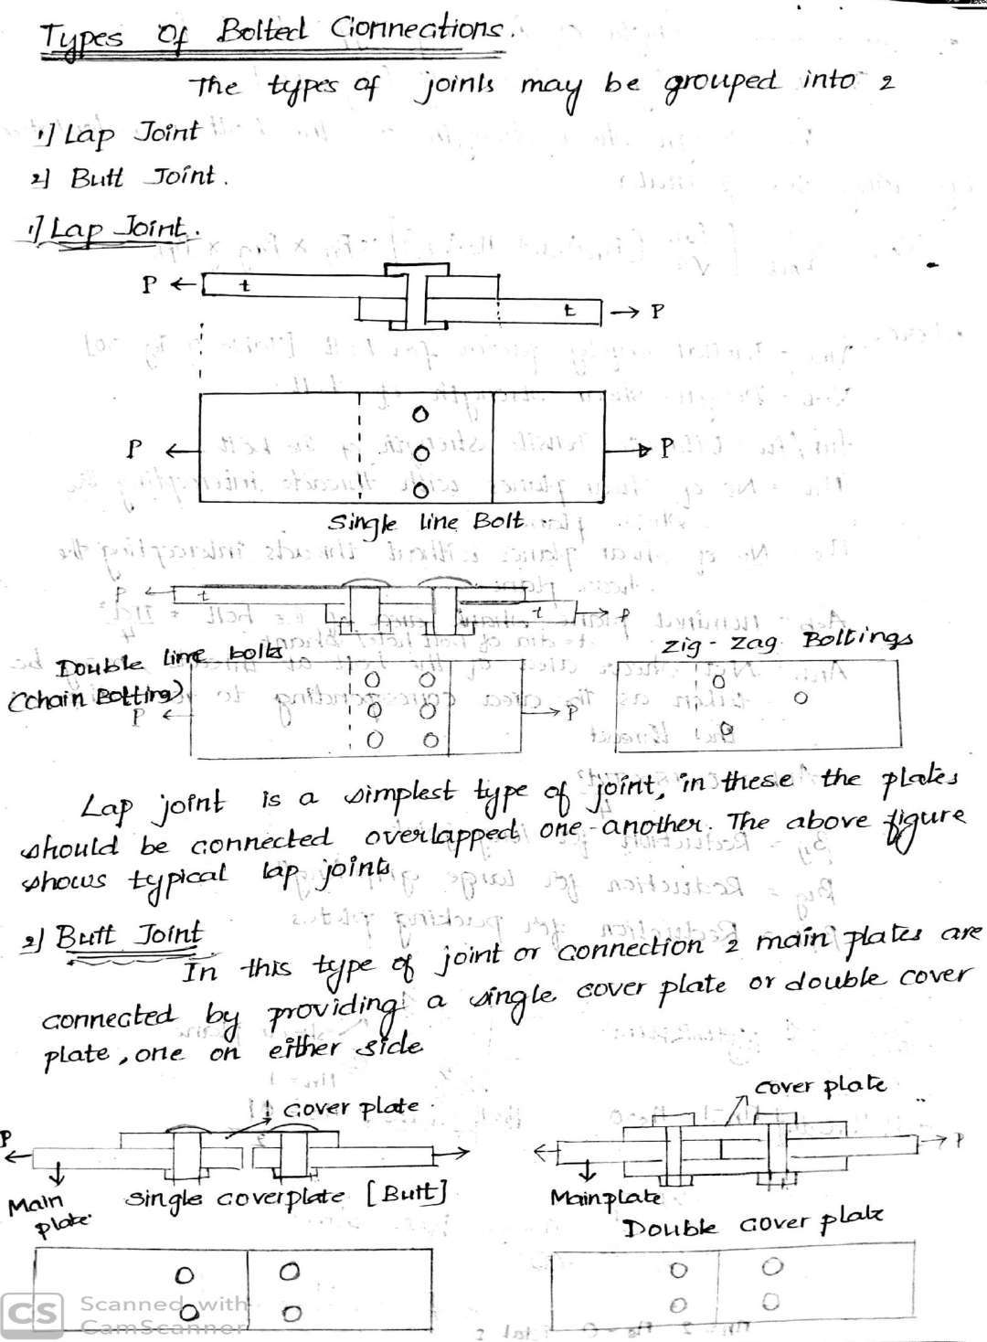

Slide 19
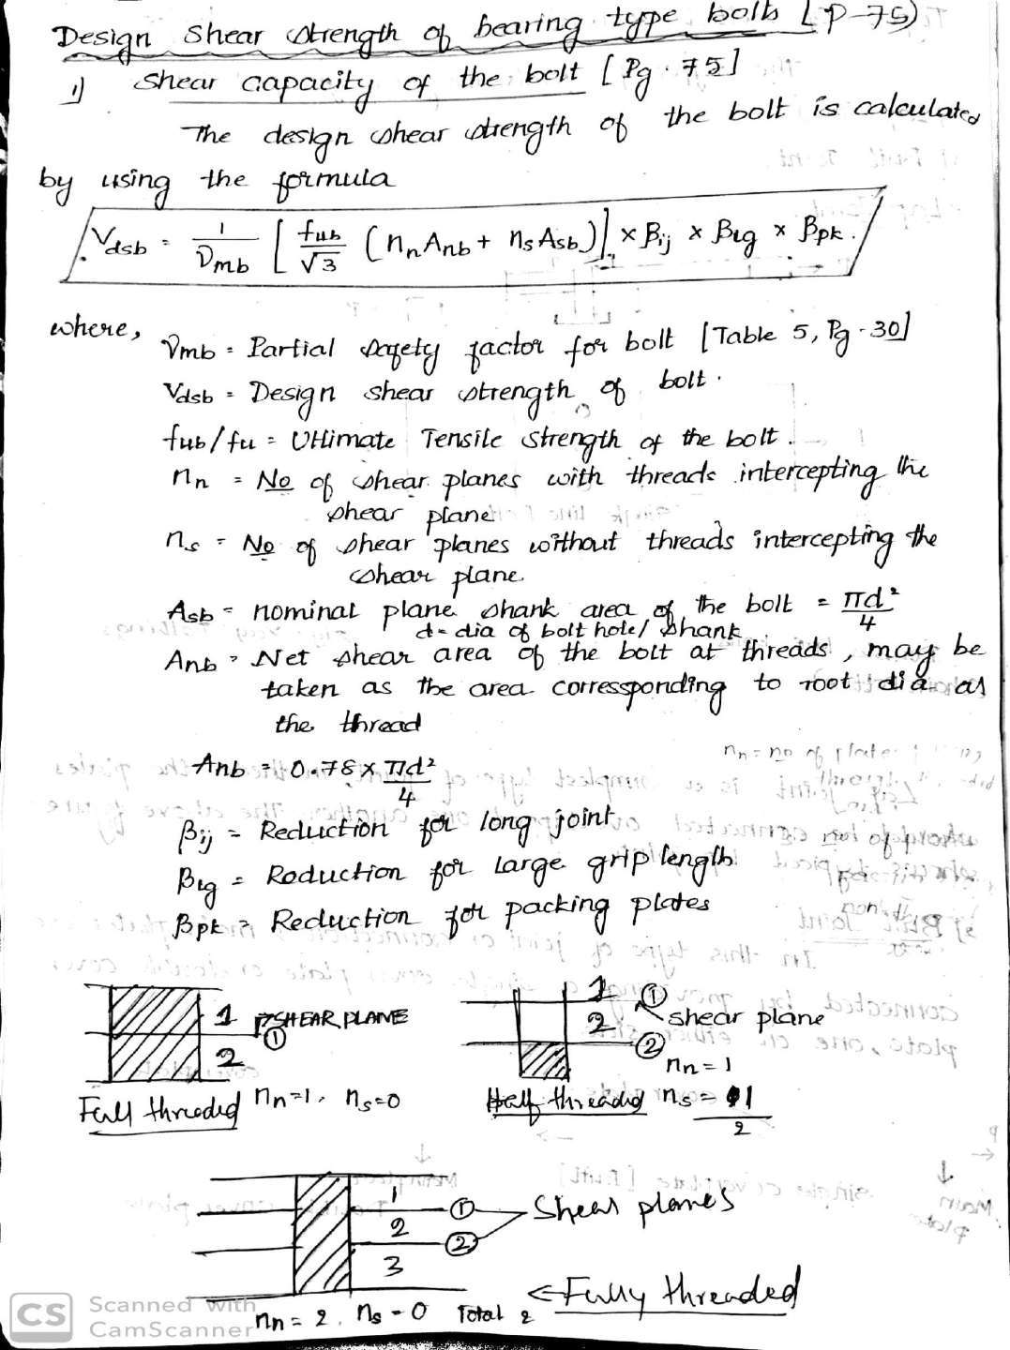

Slide 20
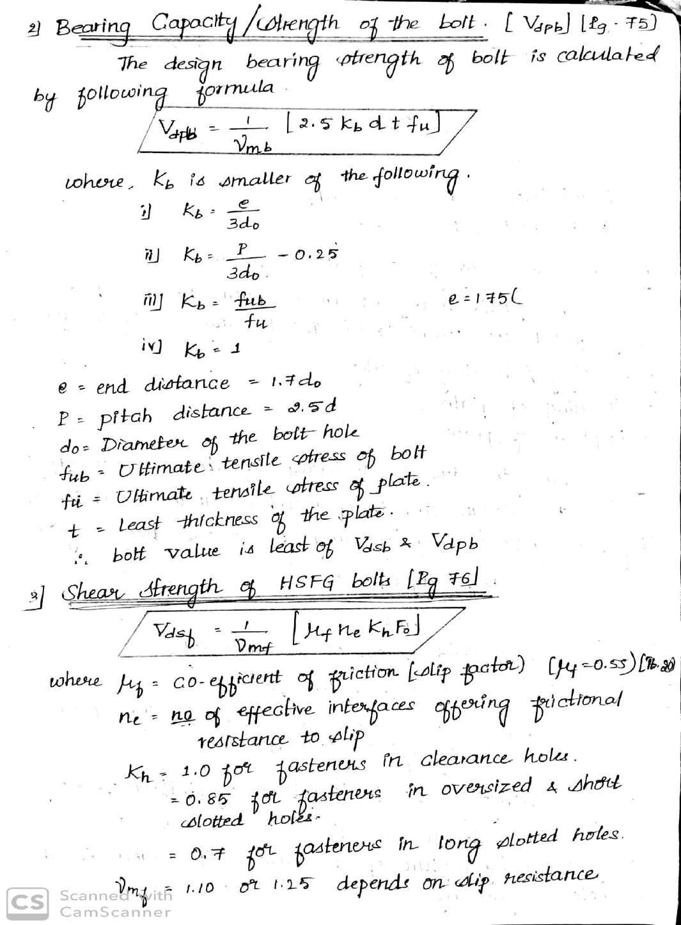

Slide 21
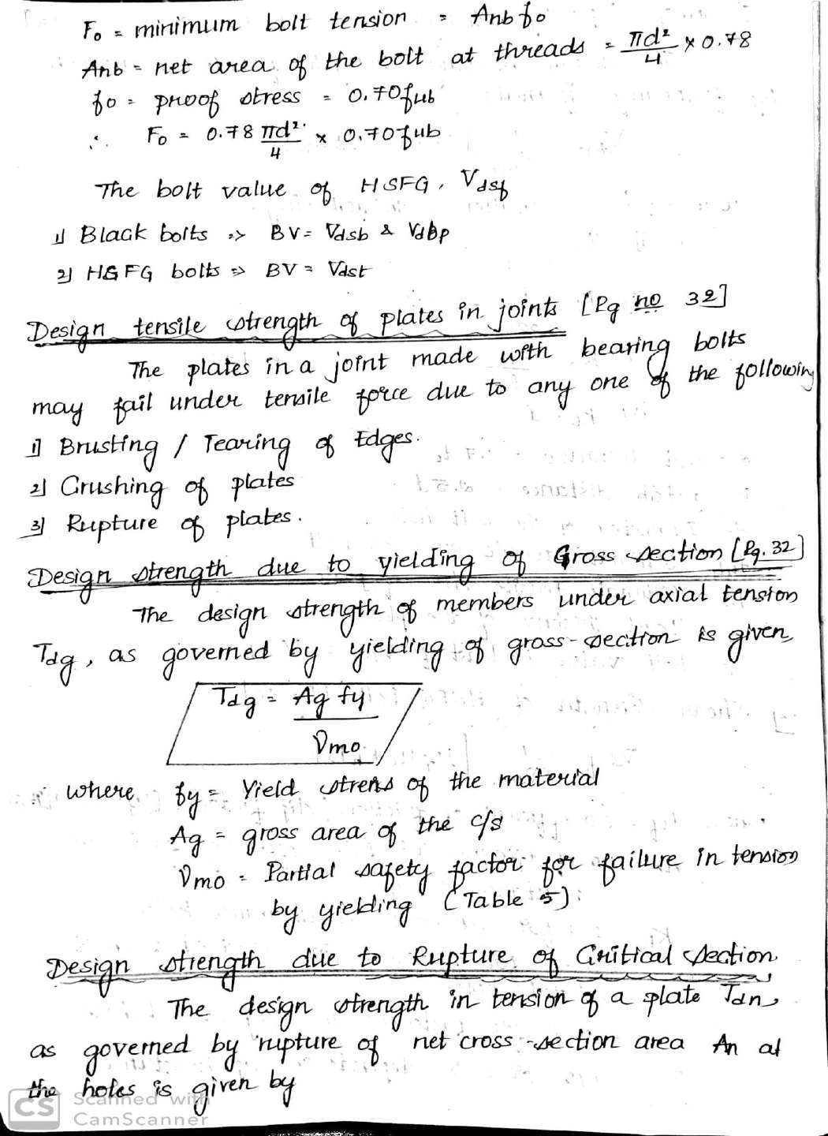

Slide 22
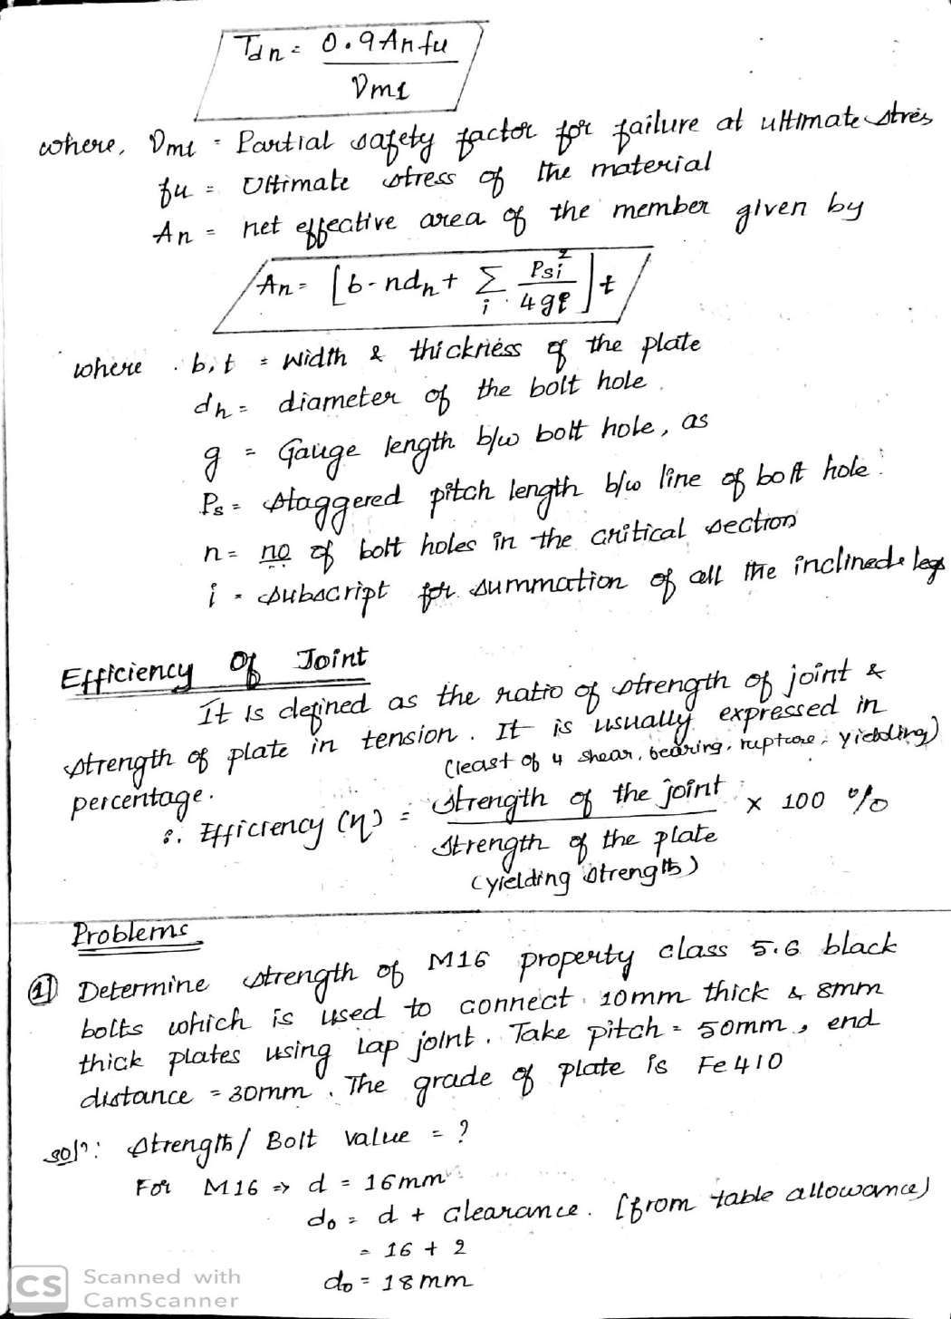

Slide 23
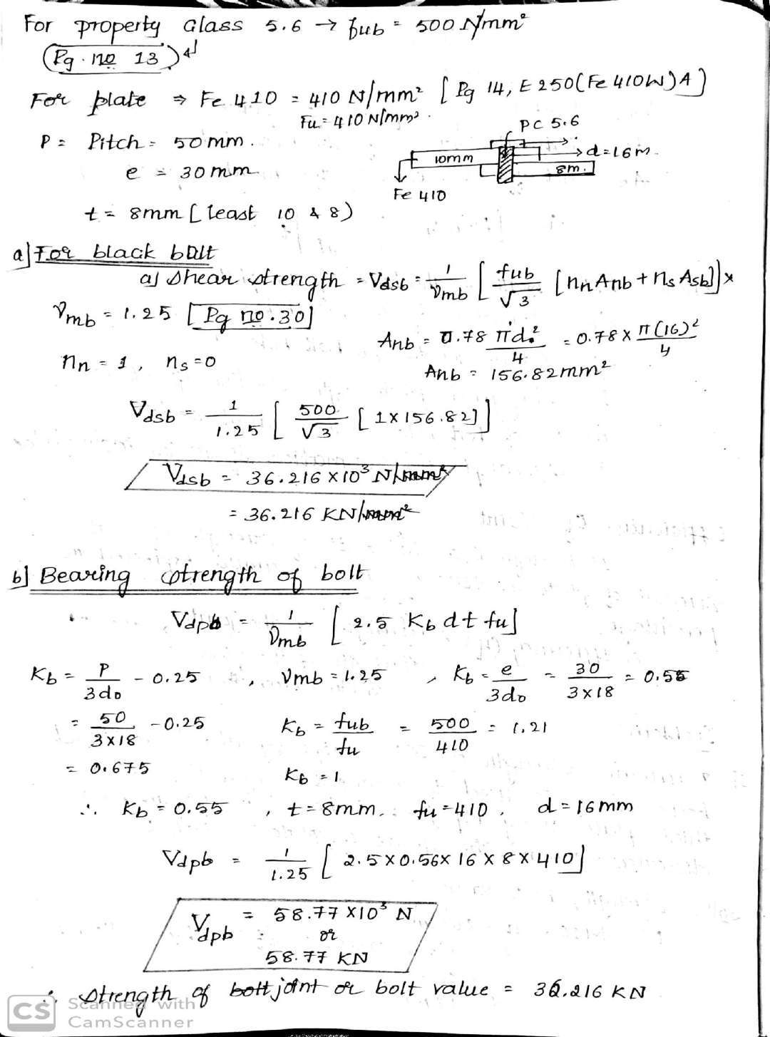

Slide 24
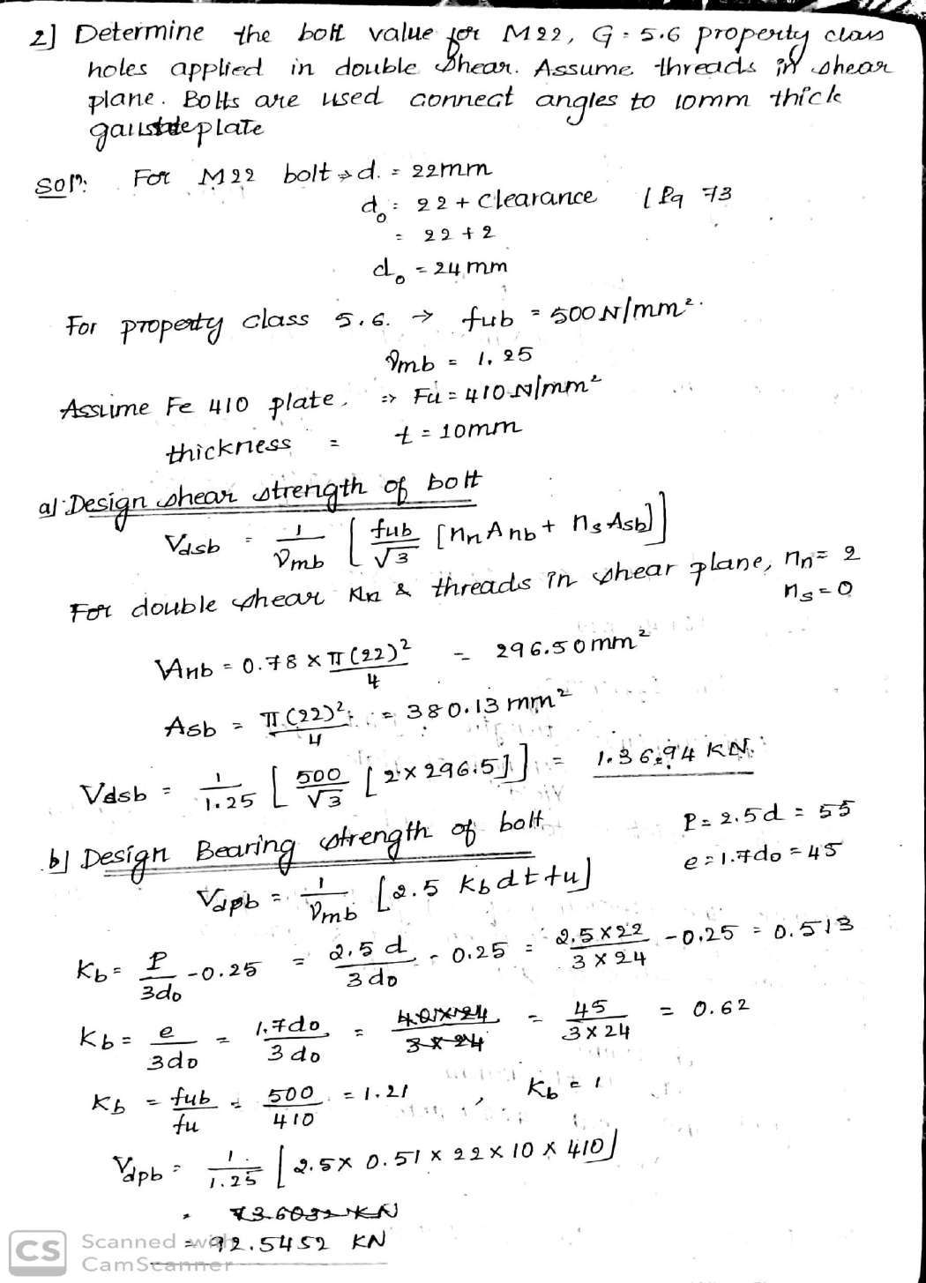

Slide 25
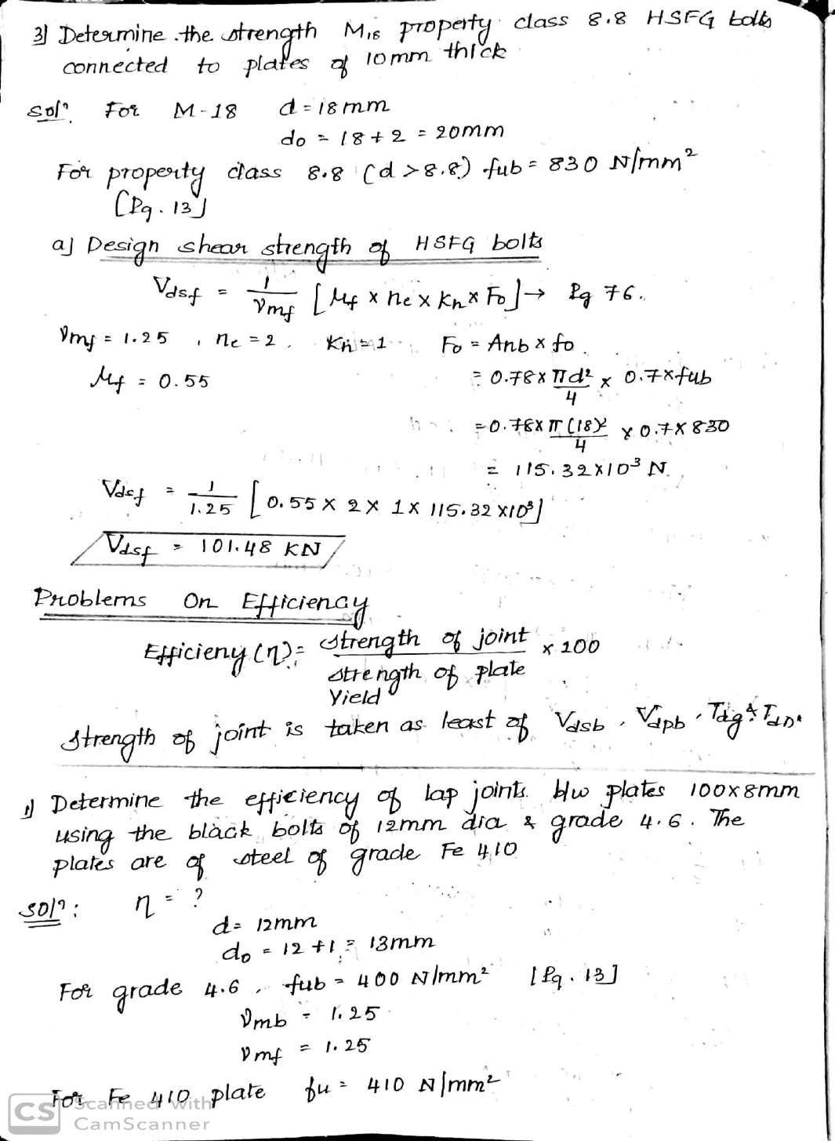

Slide 26
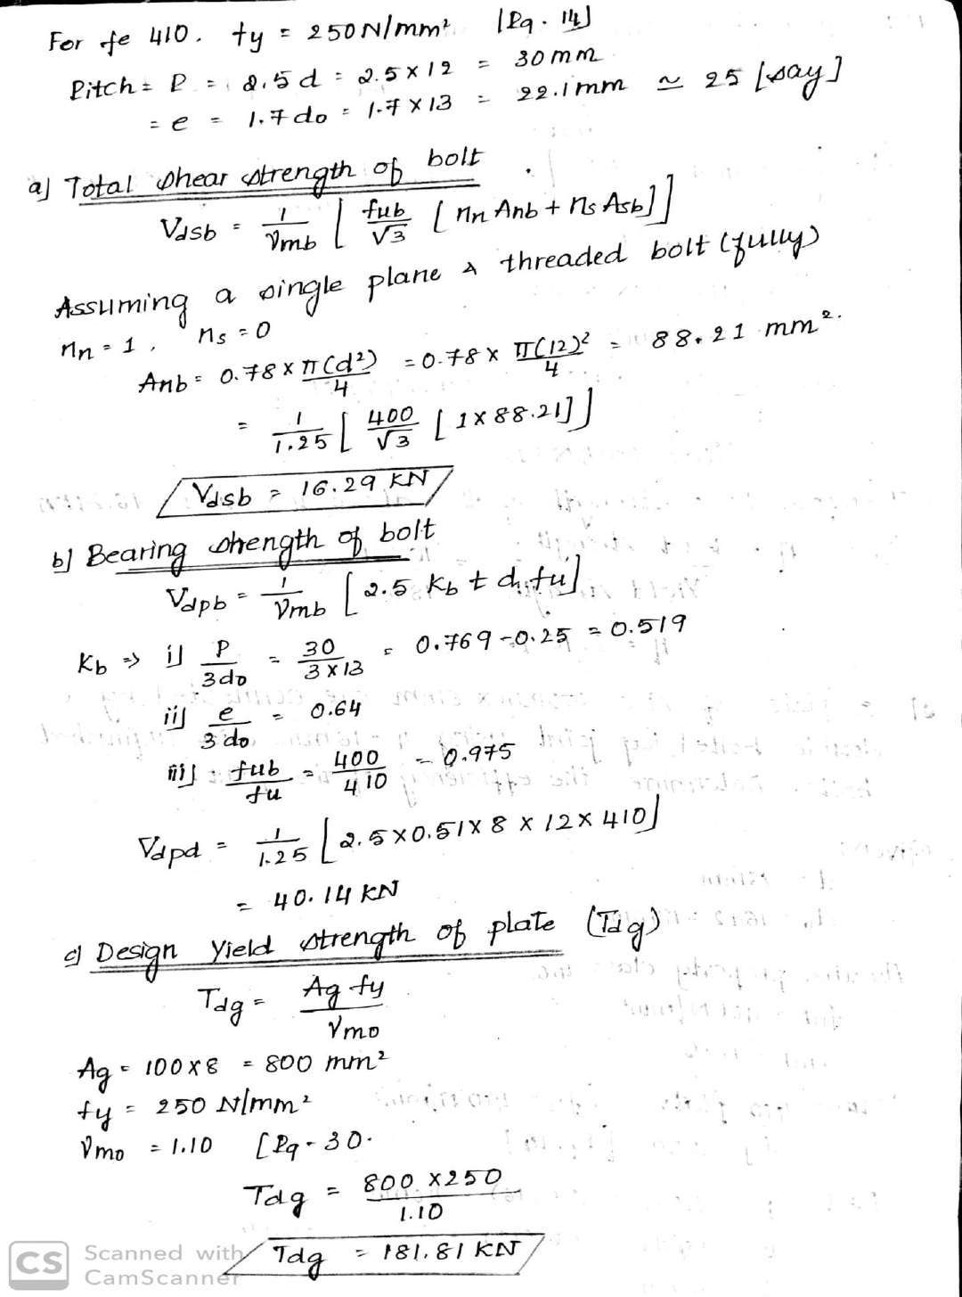

Slide 27
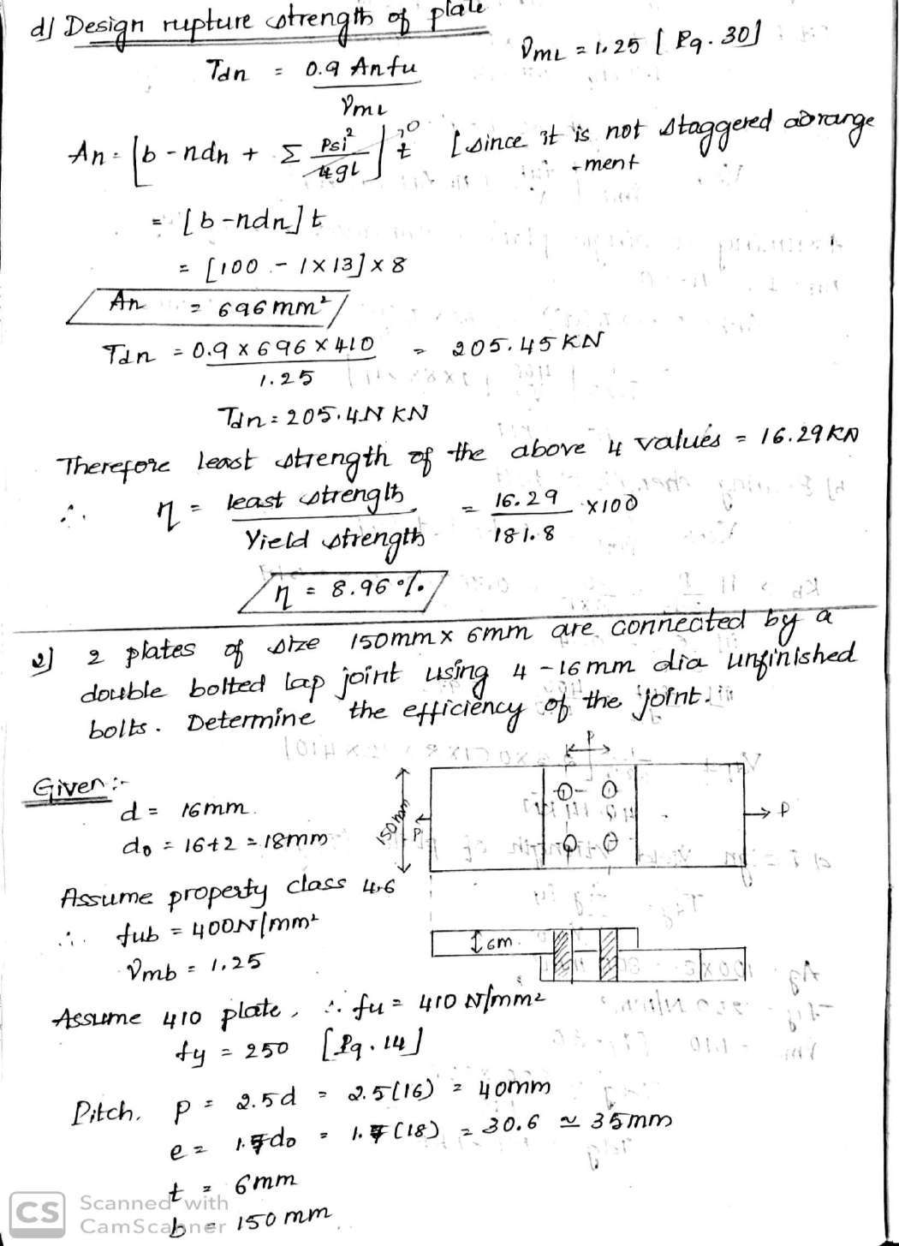

Slide 28
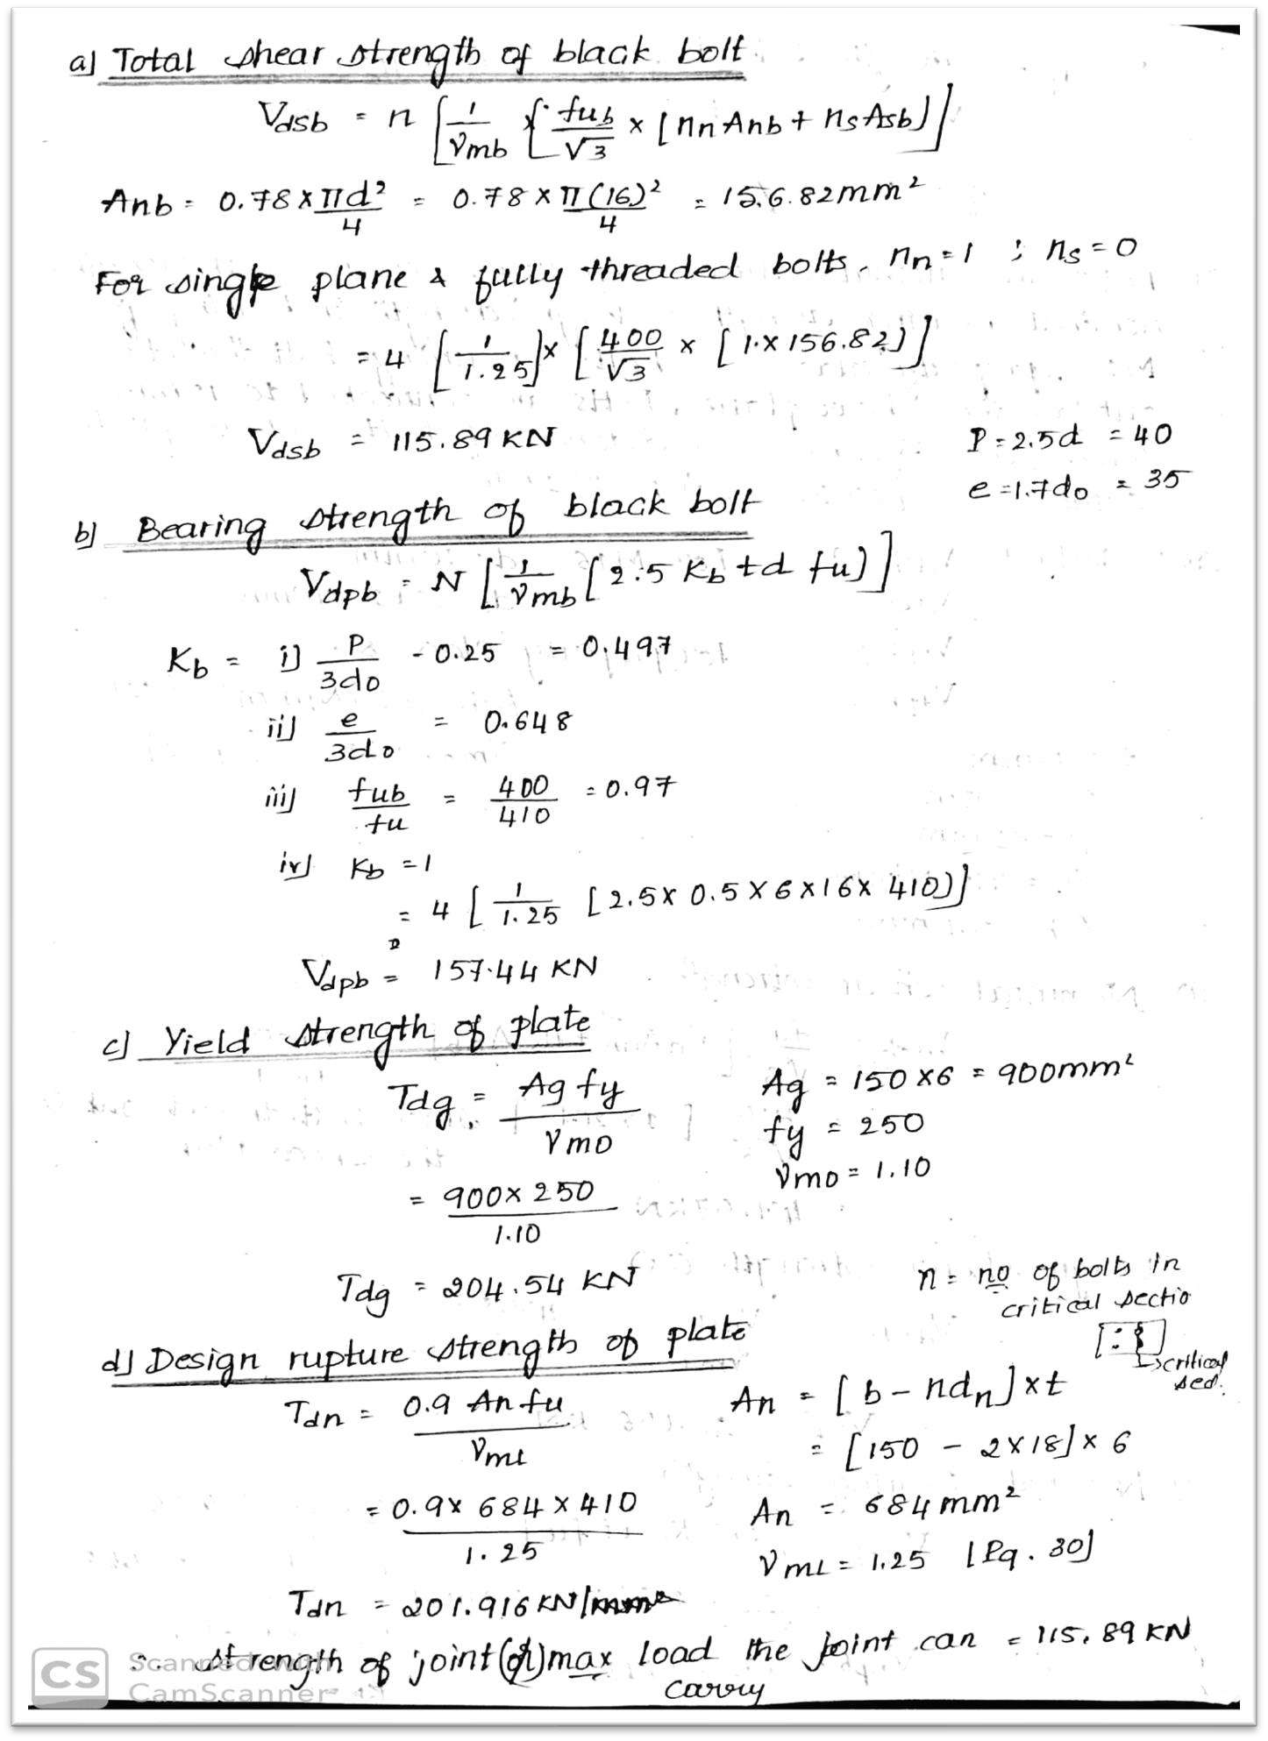

Slide 29
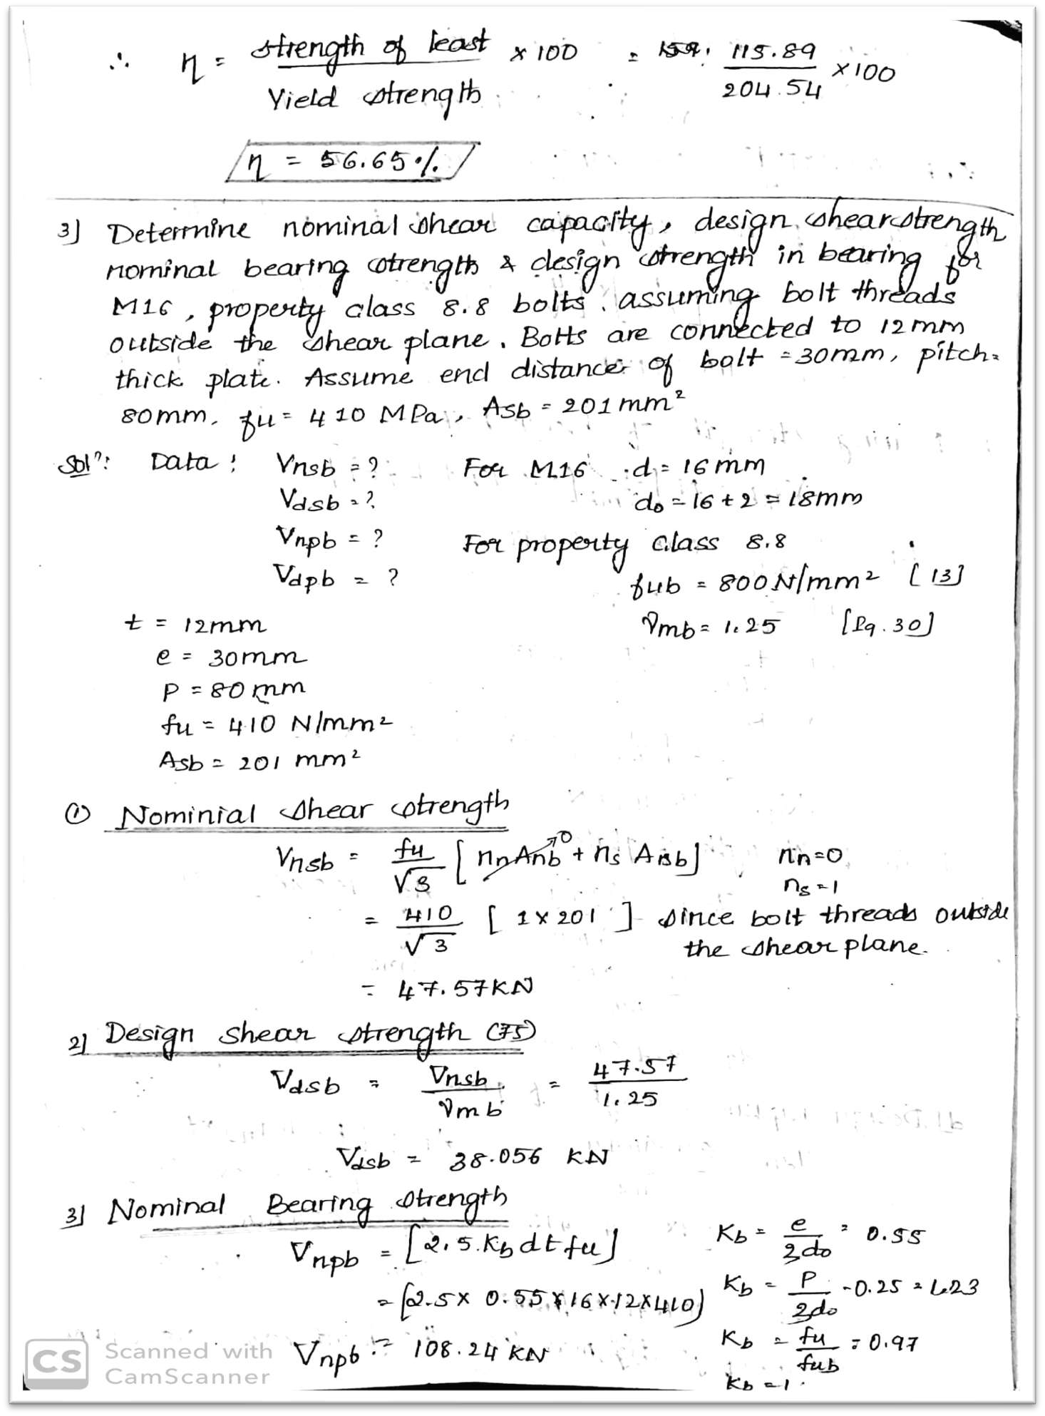

Slide 30
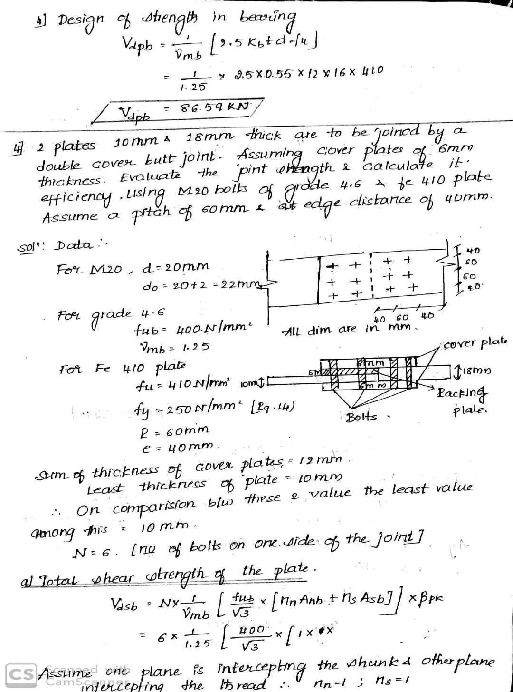

Slide 31
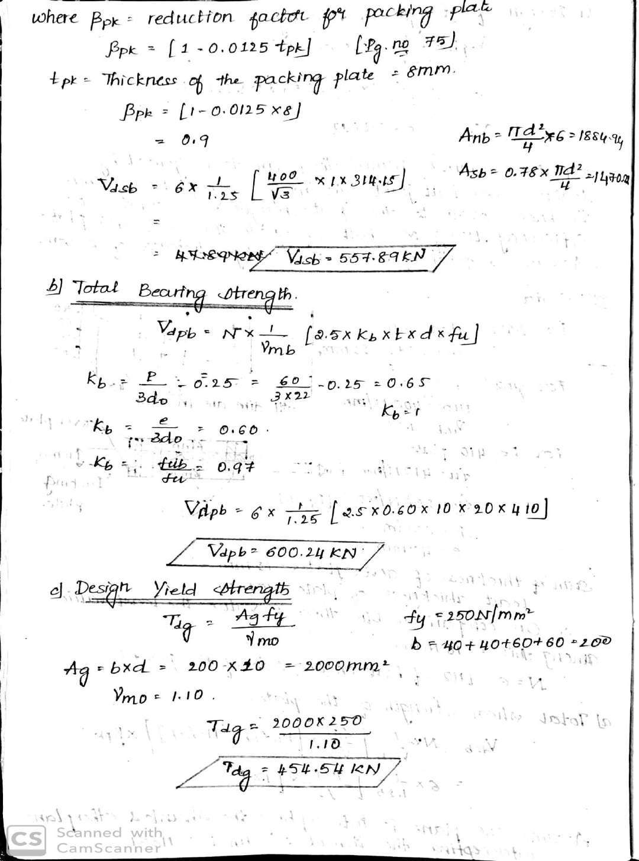

Slide 32
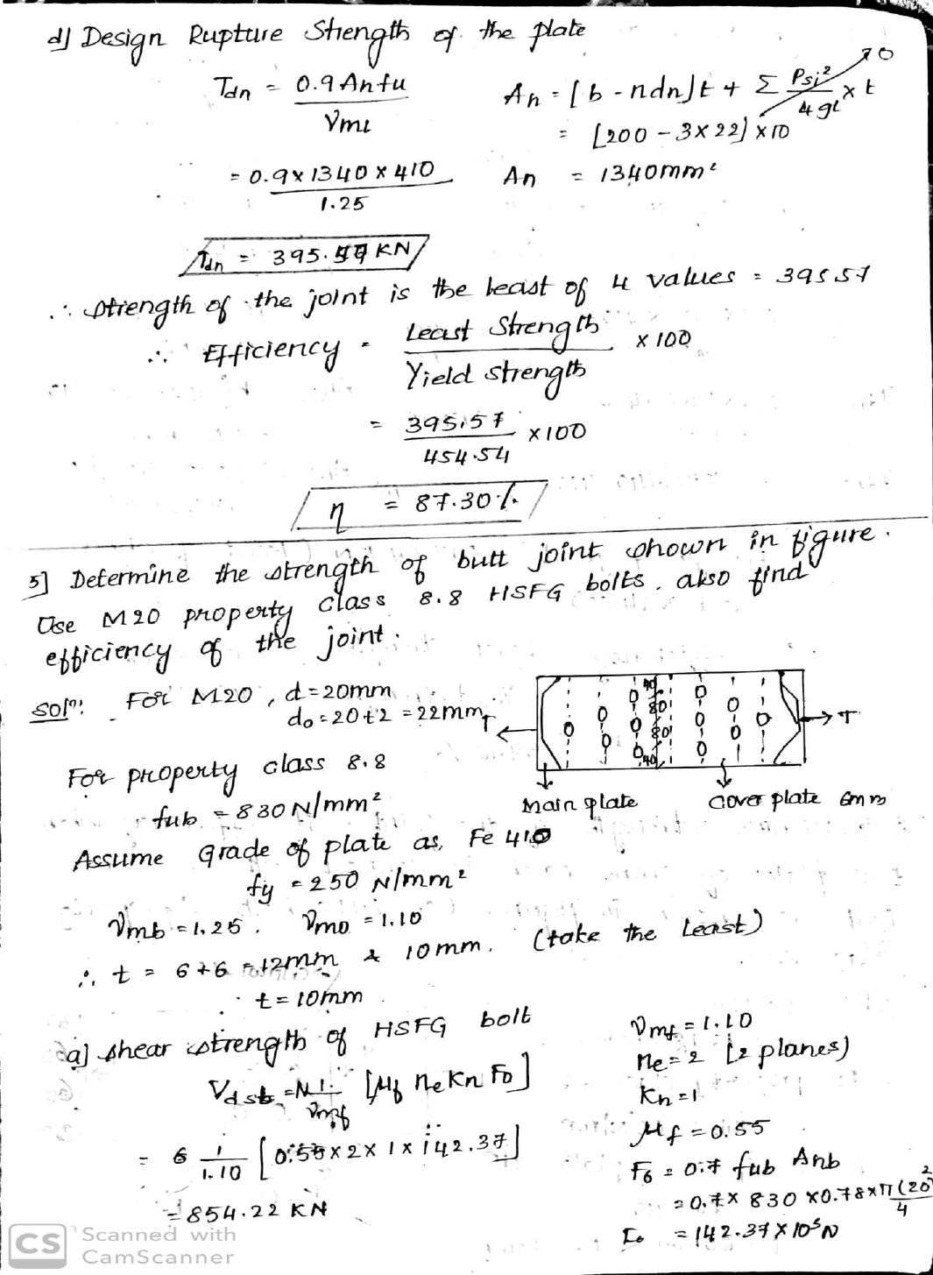

Slide 33
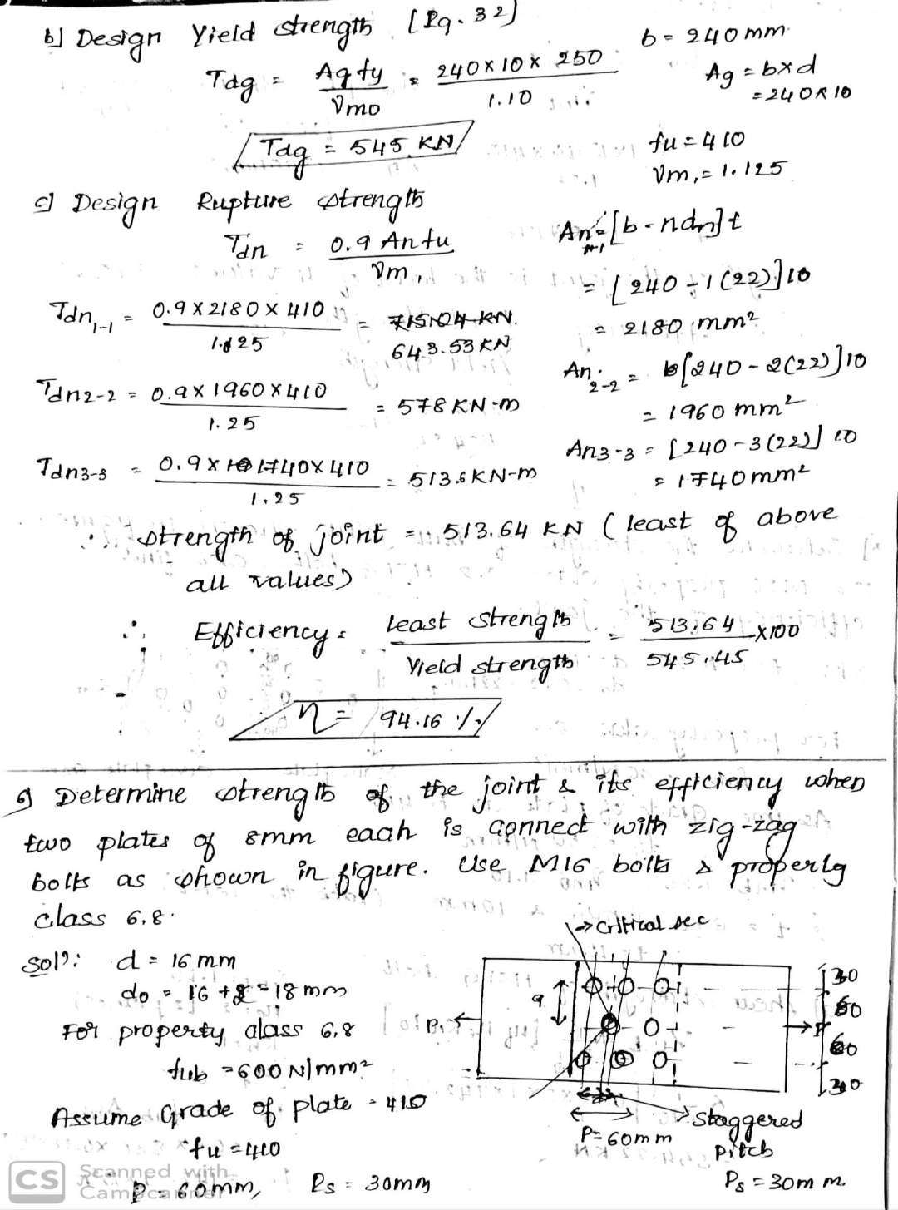

Slide 34
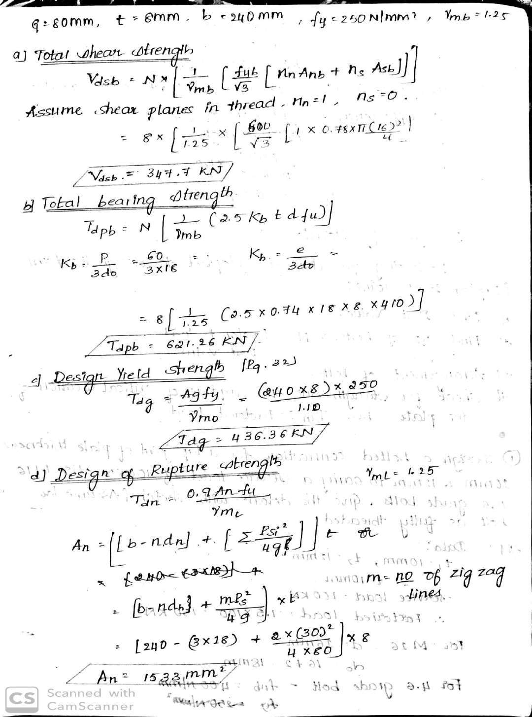

Slide 35
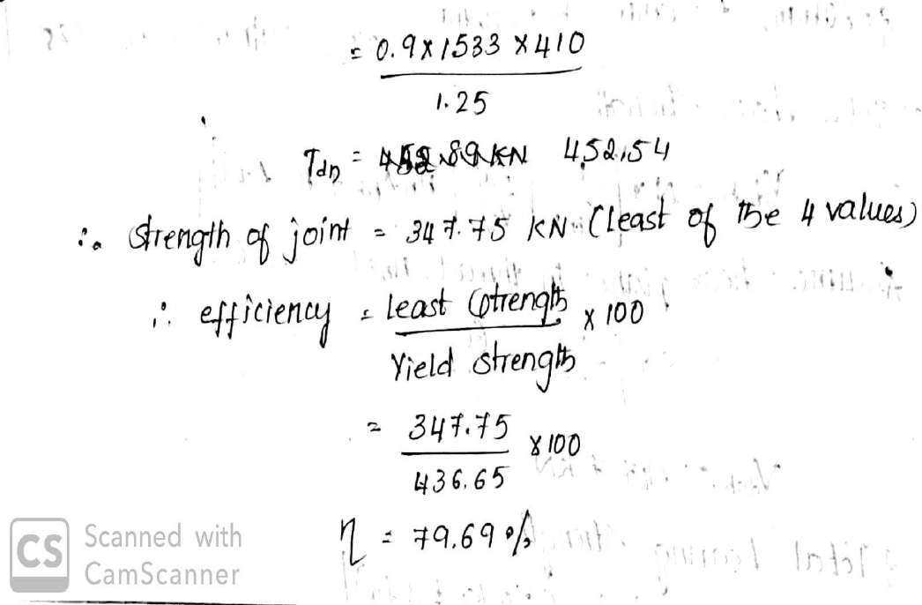

Slide 36
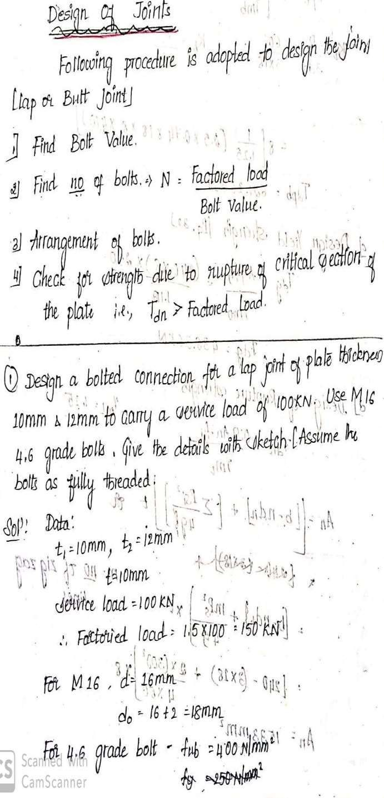

Slide 37
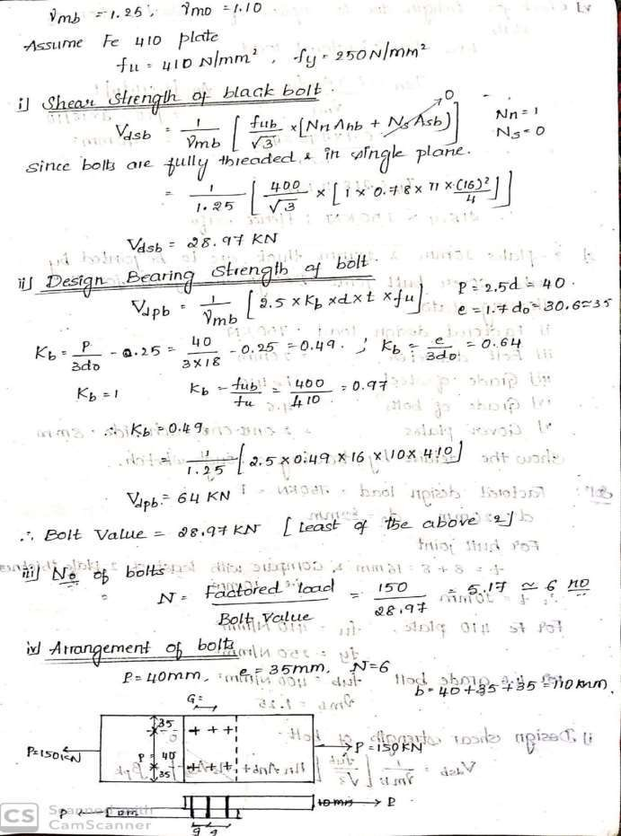
2

Slide 38
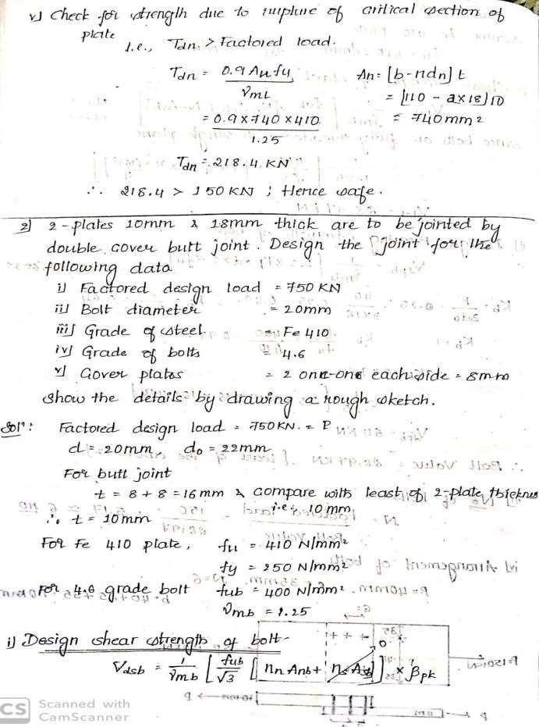
3

Slide 39
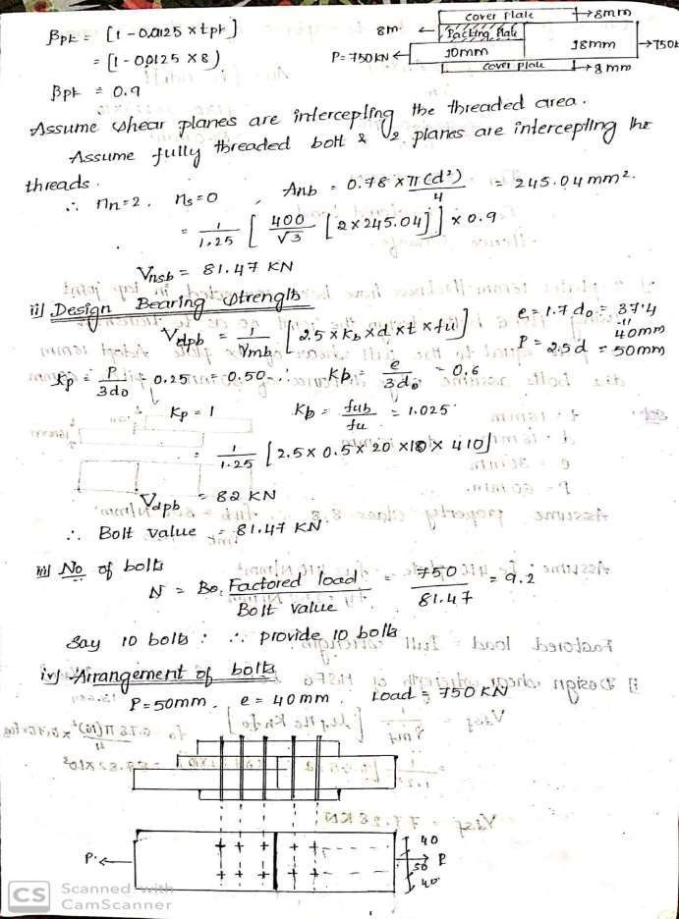
4

Slide 40
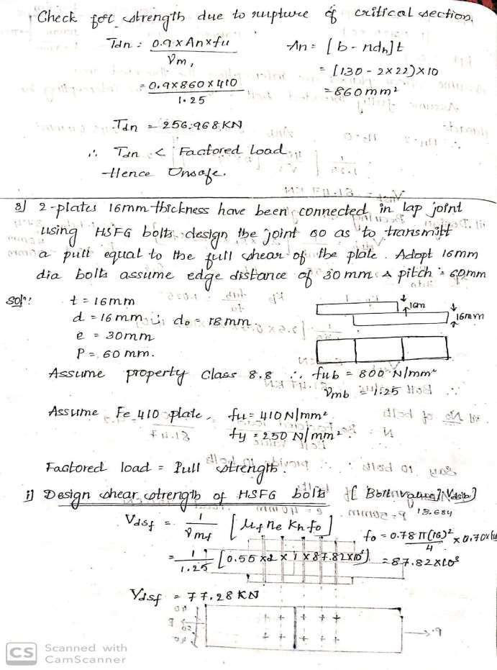
5

Slide 41
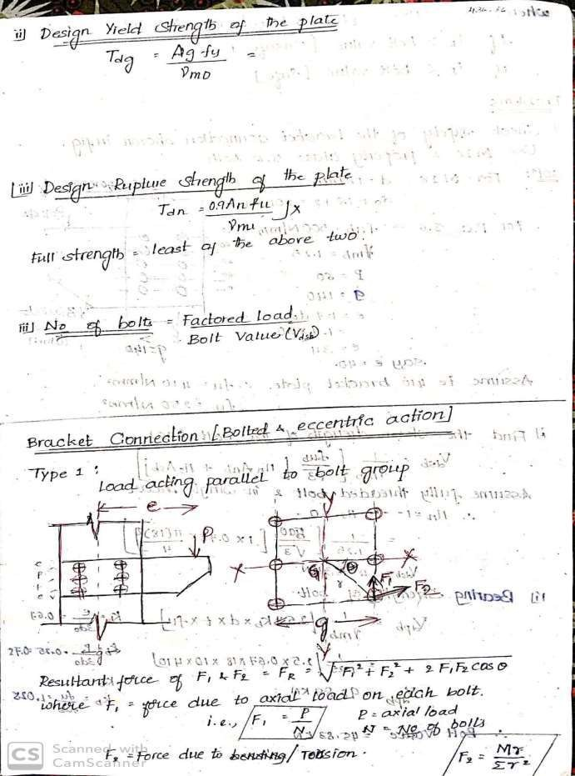
6

Slide 42
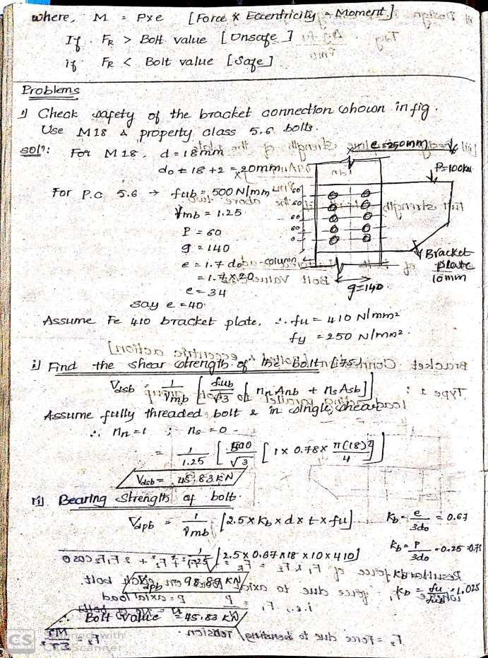
7

Slide 43
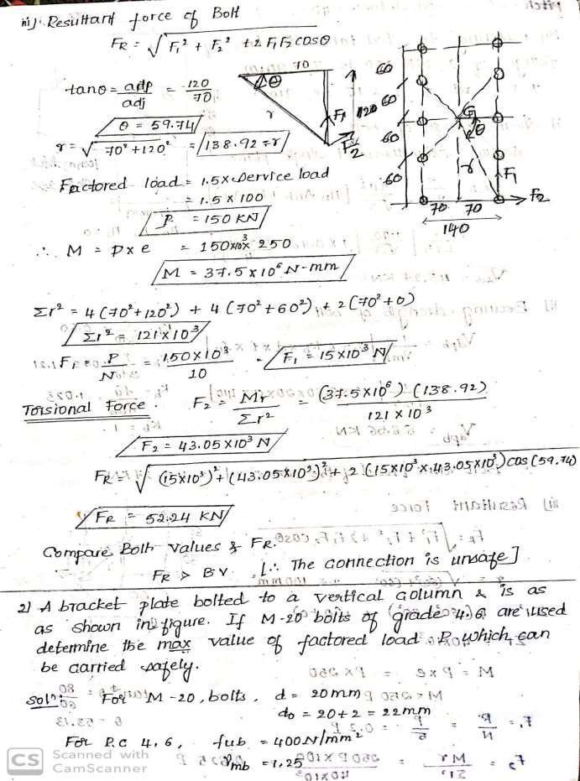
8

Slide 44
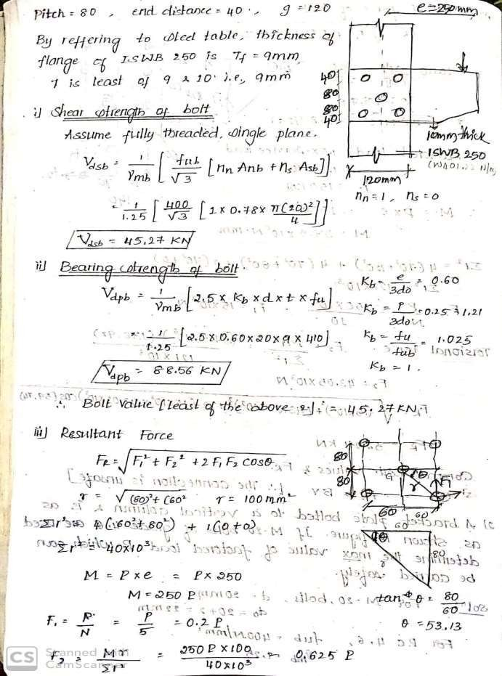
9

Slide 45
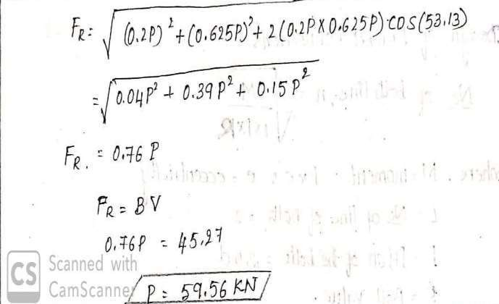

Slide 46
DESIGN OF STEEL STRUCTURAL ELEMENTS
(18CV61)
MODULE 4
DESIGN OF COLUMN BASES

Slide 47
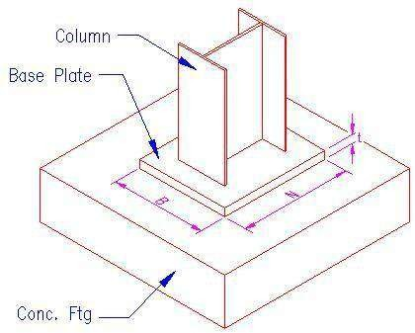
Column Bases:
DSSE
17CV62
Column Base or
or slab base
The columns are supported on the column base.
The column base is provided for transferring the load from the column to the base and to distribute it evenly on the concrete bed.
The load is also distributed over a larger area, so that the stress induced in the concrete is within its permissible limits and is capable of resisting overturning.
If column base is not provided, the column is likely to punch through the concrete block.
Mild steel plates of sufficient area are attached to the bottom of the column in order to increase the bearing area. Such plates are called column bases.
These plates are secured to the concrete block through holding down or anchor bolts.
There are two types of column bases:
Slab base
Gusseted base.
BGSIT, CIVIL DEPT.
1

Slide 48
DSSE
17CV62
Purpose of providing a column base.
Column bases are provided for following purposes
to distribute the column load to concrete pedestal or blocks
to maintain alignment of column in plan
to maintain verticality of column
to control deflection of column and frames.
Slab Base:
For columns carrying small loads, slab bases are used.
It consists of a base plate, placed below the machined column end and cleat angles.
The machined column end transfers the load to the slab base by direct bearing.
The column end is connected to base plate by
welding or by means of bolts.
In order to prevent movement of plate in the horizontal plane, four bolts are provided in the four corners of the plate and this bolts are called as anchor bolts or holding down bolts.
BGSIT, CIVIL DEPT.
2

Slide 49
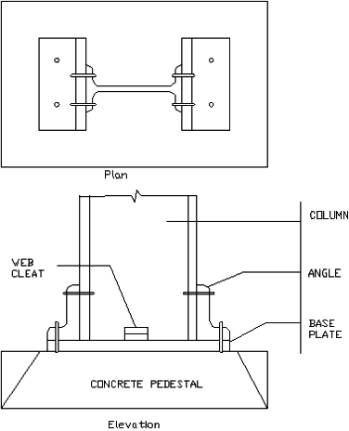
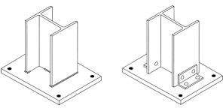
DSSE
17CV62
PLAN AND ELEVATION OF SLAB BASE
Slab base with Welded Connection
Slab base with Bolted
Connection
BGSIT, CIVIL DEPT.
3

Slide 50
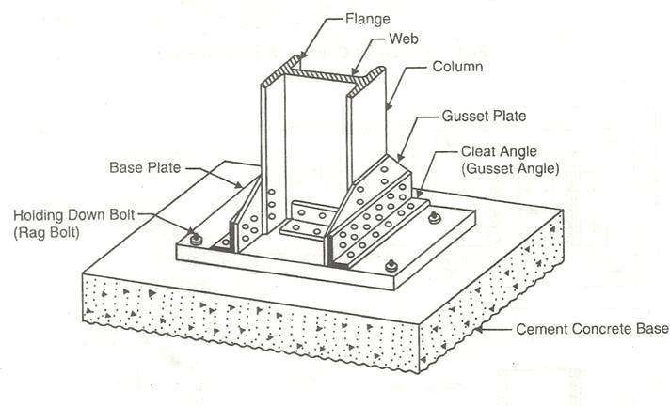
Gusseted Base:
DSSE
17CV62
For columns carrying heavy loads gusseted bases are used.
The loads are transmitted to the base plate through the gusset plates attached to the flanges of the column by means of cleat angles.
So the gusseted base consists of base plate, gusset plates and cleat angles or gusset angels.
The base plate is anchored at the four corners to the foundation with bolts to check the lateral movement.
The foundation is generally of cement concrete and transmits the load over a larger area with uniform distribution of pressure.
BGSIT, CIVIL DEPT.
4

Slide 51
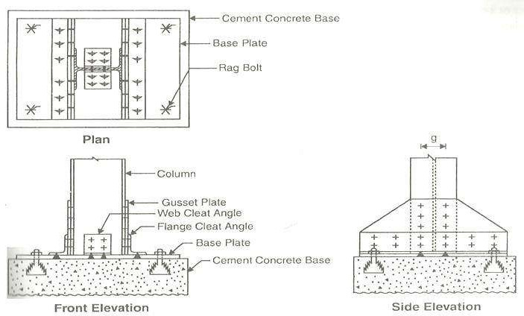
DSSE
17CV62
Plan, Front Elevation and Side Elevation of Gusseted Base.
BGSIT, CIVIL DEPT.
5

Slide 52
DSSE
17CV62
Following steps are used to design a slab base:
i. Area of the slab base (base plate)
𝐴𝑟𝑒𝑎 =
𝐹𝑎𝑐𝑡𝑜𝑟𝑒𝑑 𝑙𝑜𝑎𝑑
𝐵𝑒𝑎𝑟𝑖𝑛𝑔 𝑠𝑡𝑟𝑒𝑛𝑔𝑡ℎ 𝑜𝑓 𝐶𝑜𝑛𝑐𝑟𝑒𝑒
Bearing strength of concrete = 0.45 x fck
Find the projections ‘a’ and ‘b ‘ by using the equation
Area = (h+2a) * (bf*2b)
For Economy, as far as possible take the values of a & b as same.
ii. Thickness of base slab:
Thickness of base slab is calculated by using the equation:
𝑡_{𝑠} =
2.5𝑤(𝑎²−0.3𝑏² ) 𝛾
^{𝑚𝑜} > t_{f} …….page 47
𝑓_{𝑦}
Where
w = Uniform upward pressure from concrete
= Load/Area of base plate
a & b = Larger & smaller projection respectively of
the slab beyond the rectangle circumscribing the column
t_{f} = Flange thickness of compression member.
iii. Connection:
a. Welded connection
Assuming size of the weld s = 8mm and equating
Force = Strength of the weld, Find the length of the weld
i.e., Force = 0.7 x s x L x b. Bolted connection
𝑓𝑢
√3𝛾_{𝑚𝑤}
No. of Bolts =
𝐹𝑎𝑐𝑡𝑜𝑟𝑒𝑑 𝐿𝑜𝑎𝑑
iv. Design of Concrete Base:
𝐵𝑜𝑙𝑡 𝑉𝑎𝑙𝑢𝑒
Find the area of Concrete base =
𝑇𝑜𝑡𝑎𝑙 𝐿𝑜𝑎𝑑
𝑆𝐵𝐶 𝑜𝑓 𝑠𝑜𝑖𝑙
BGSIT, CIVIL DEPT.
6

Slide 53
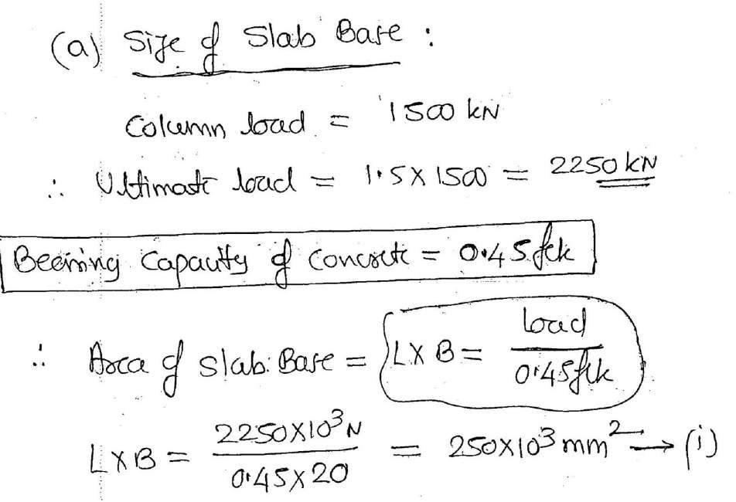
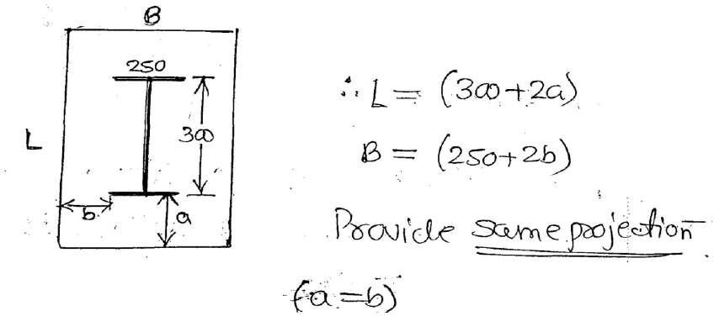
DSSE 17CV62
Problems:
1. Design a slab base for a column ISHB 300 @ 583.8 Kg/m subjected to a service load of 1500 KN. The grade of concrete for pedestal is M20 and SBC of soil is 180 KN/m². Design slab base and concrete base with welded connection.
BGSIT, CIVIL DEPT.
7

Slide 54
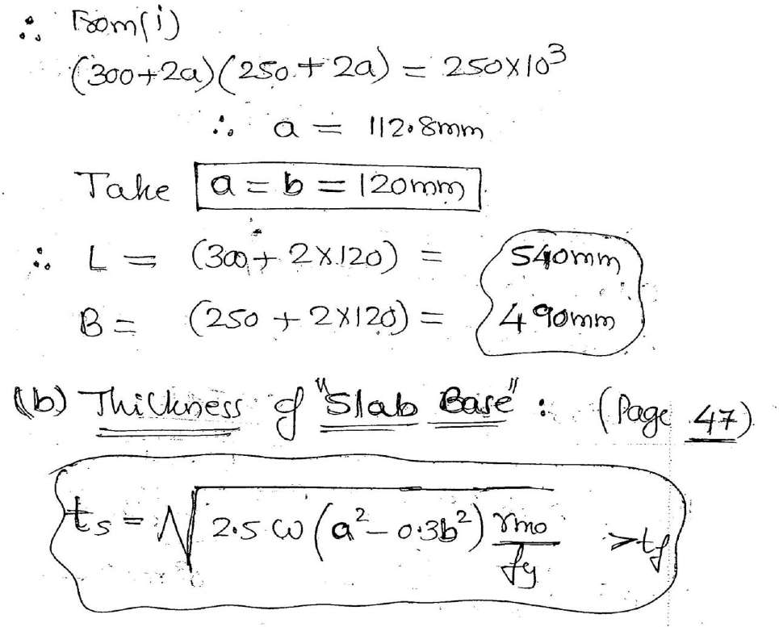
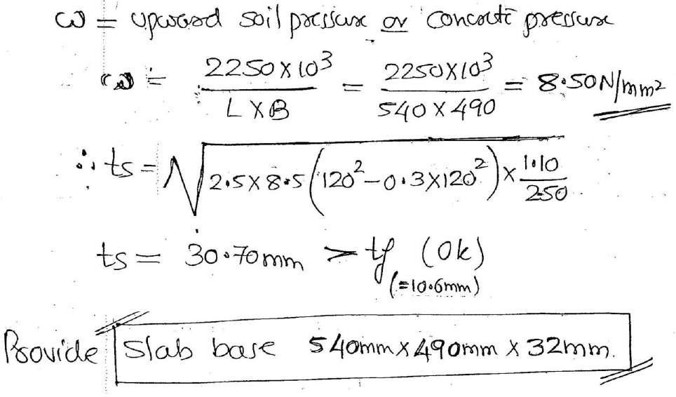
DSSE
17CV62
BGSIT, CIVIL DEPT.
8

Slide 55
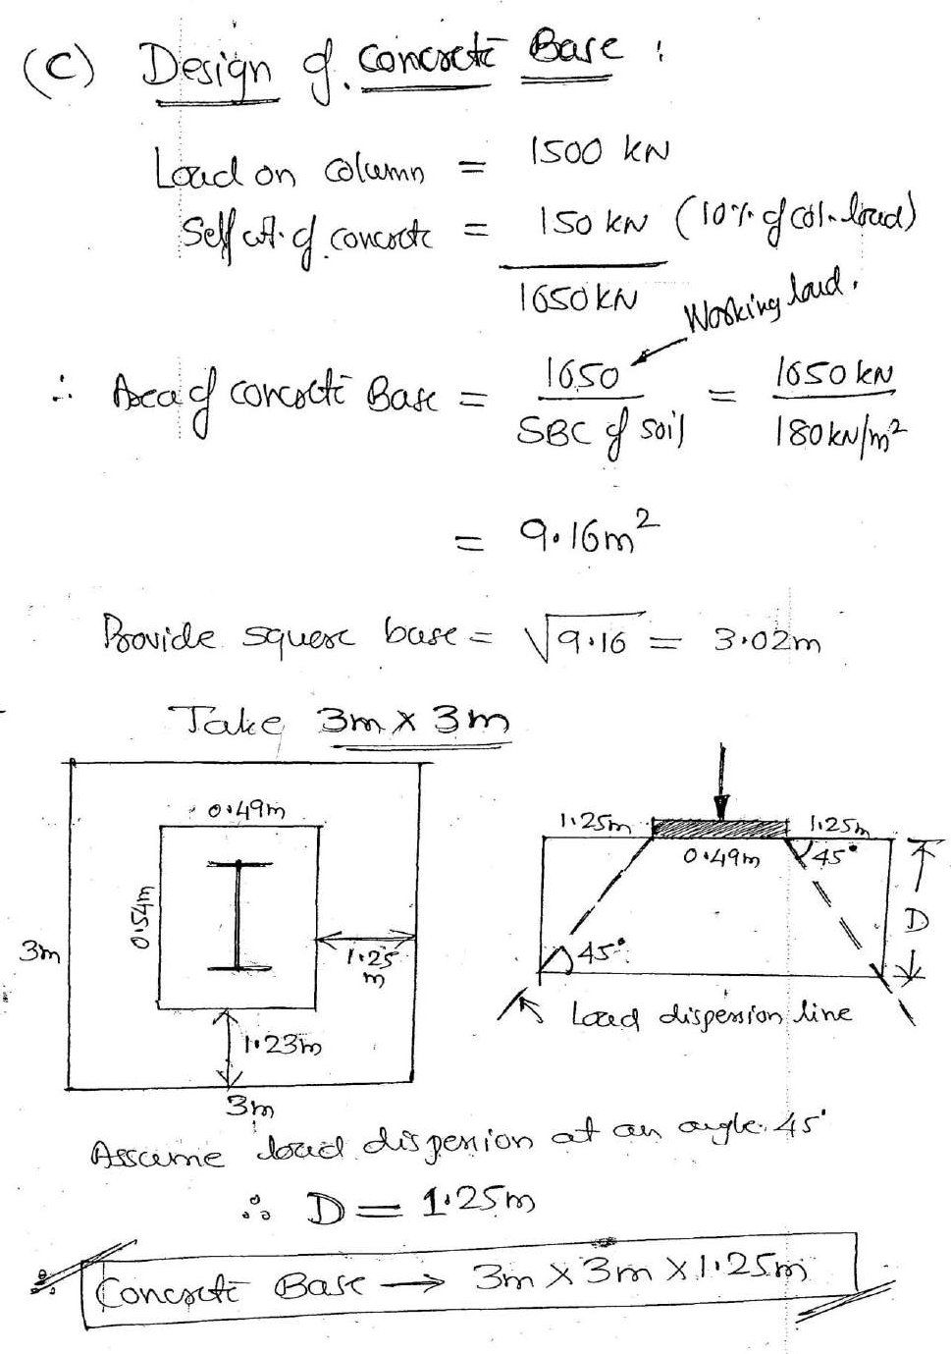
DSSE
17CV62
BGSIT, CIVIL DEPT.
9

Slide 56
DSSE
17CV62
2. Design a gusseted base on a concrete pedestal for a column ISHB 400 @ 759 N/m with two flanged plates 400 x 20mm carrying a factored load of 4000 KN. The column is to be supported on concreted pedestal build with M20 concrete. Take SBC of soil as 225 KN/m²
BGSIT, CIVIL DEPT.
10

Slide 57
DSSE
17CV62
BGSIT, CIVIL DEPT.
11

Slide 58
DSSE
17CV62
BGSIT, CIVIL DEPT.
12

Slide 59
DSSE
17CV62
BGSIT, CIVIL DEPT.
13

